Slide 1
Tutorial Machine Learning in Solid Mechanics
Task 1: Feed-Forward Neural Networks
Fabian Roth

Slide 2
Tutorial Machine Learning in Solid Mechanics
Sections
1
Hyperparameter sweep
2
Input convex neural networks
3
Trainable custom layer
4
Sobolev training

Slide 3
Task 1 – 1.1
Hyperparameter sweep

Slide 4
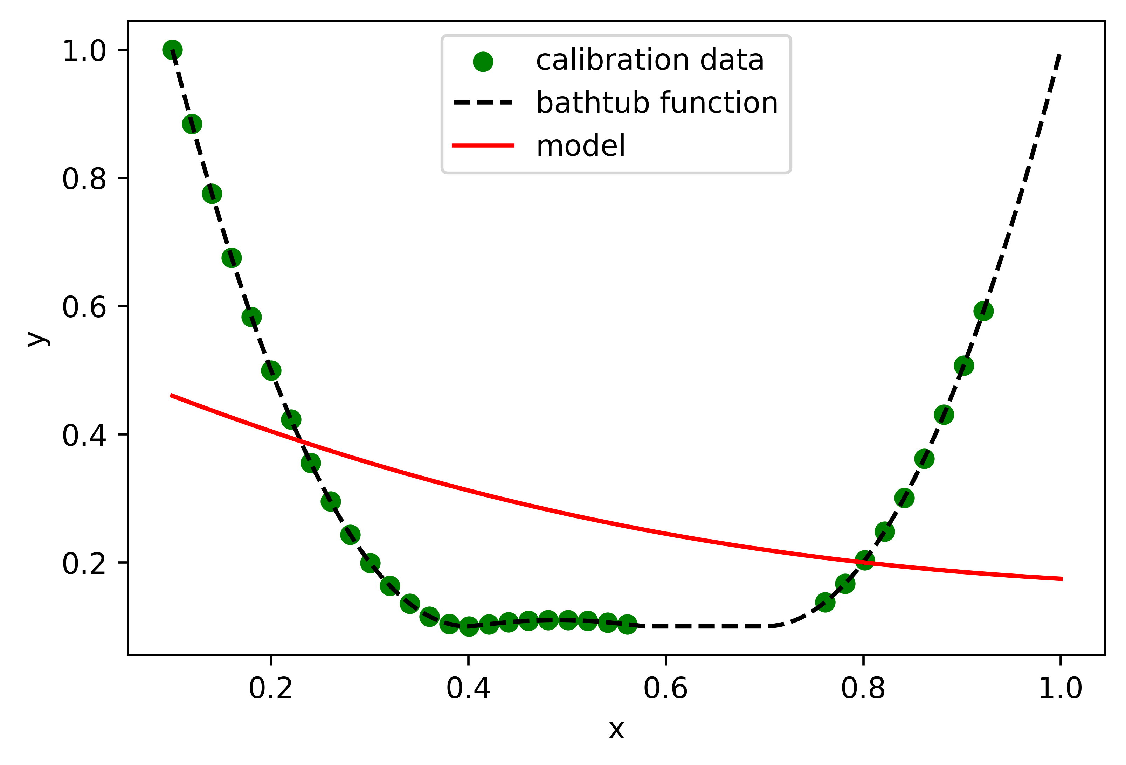
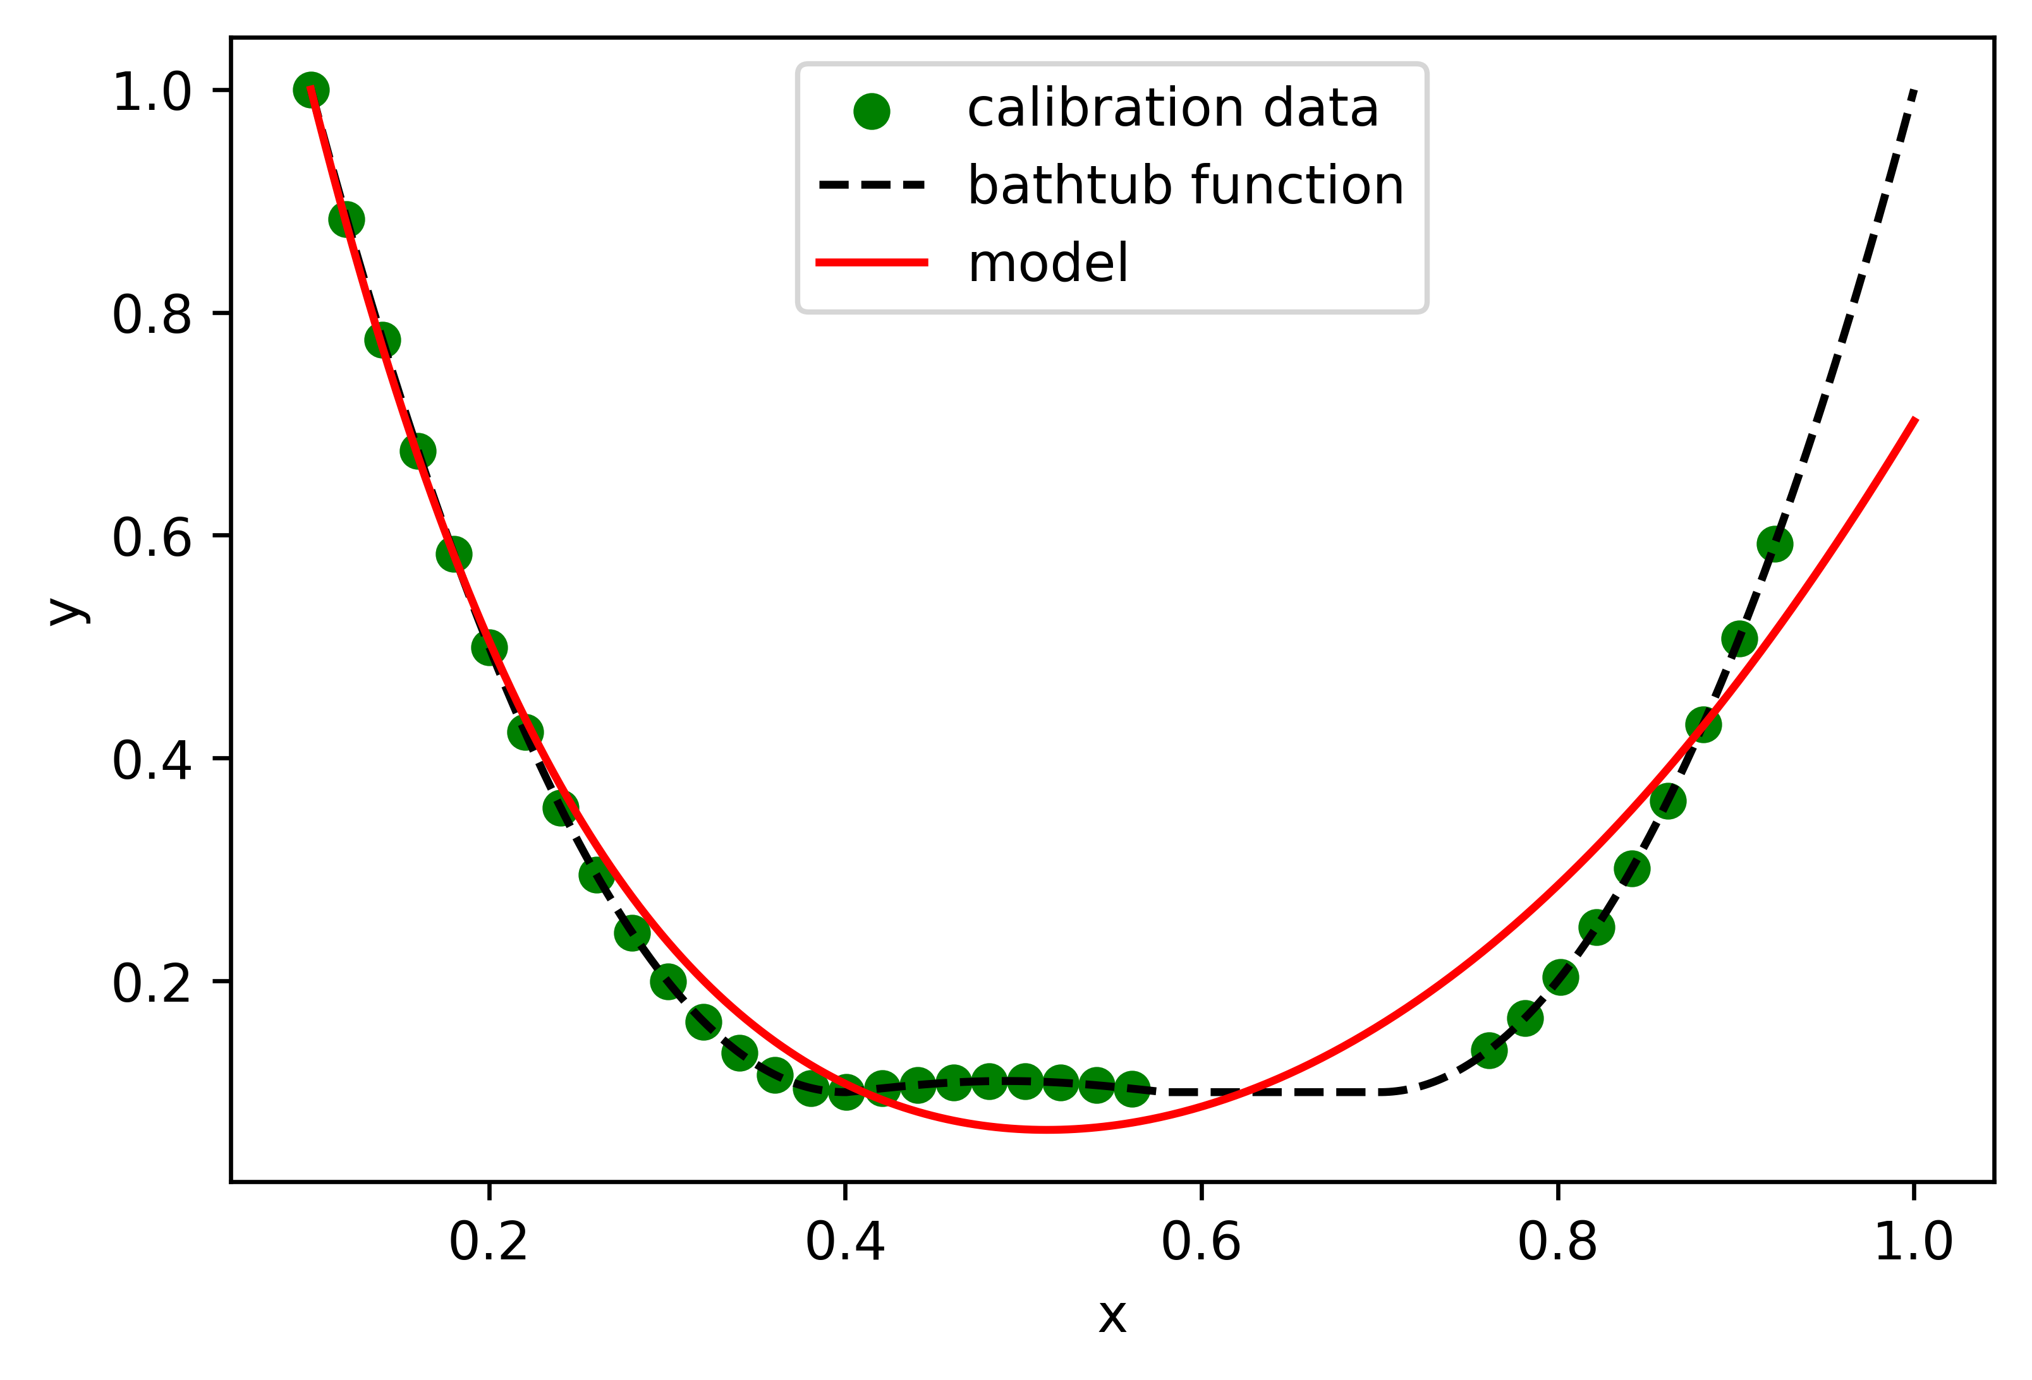
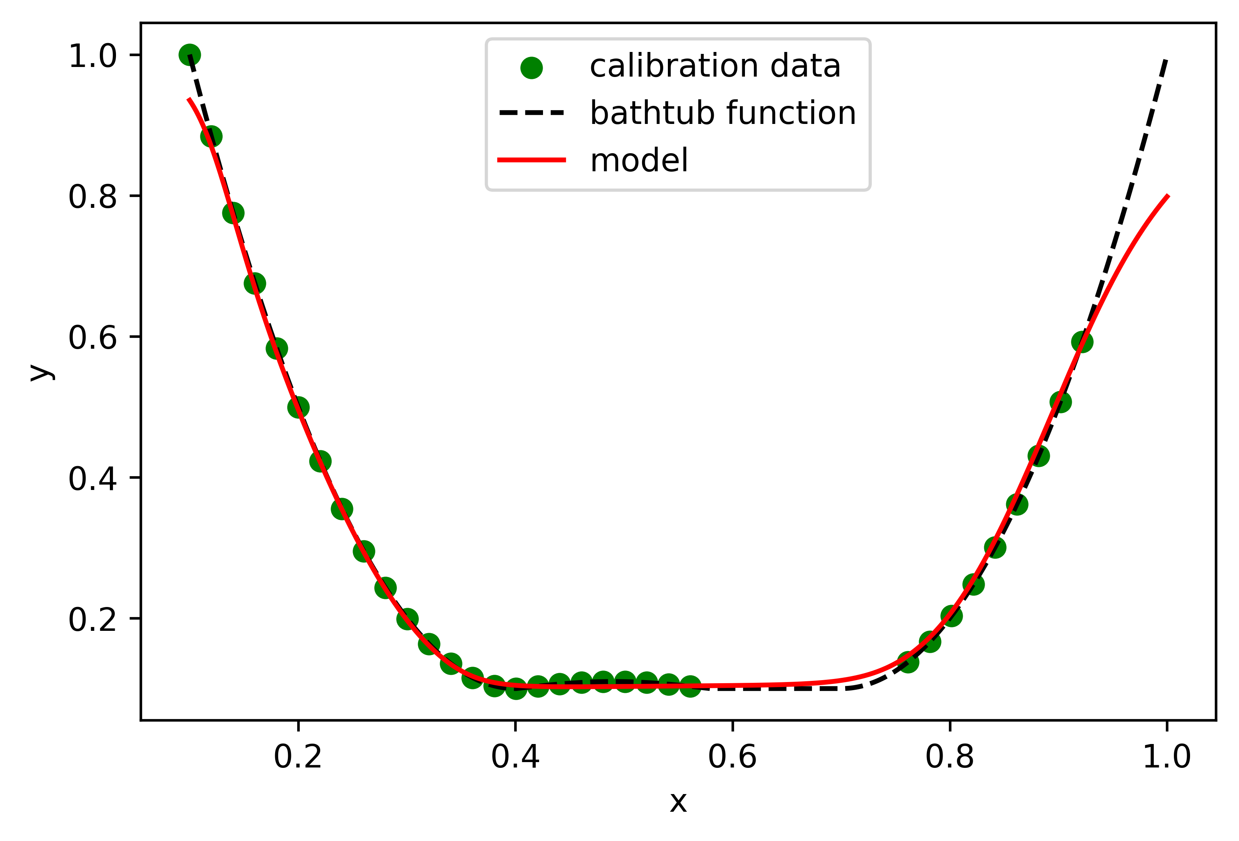
Hyperparameter sweep
Model Complexity
More Layers and Nodes

Slide 5
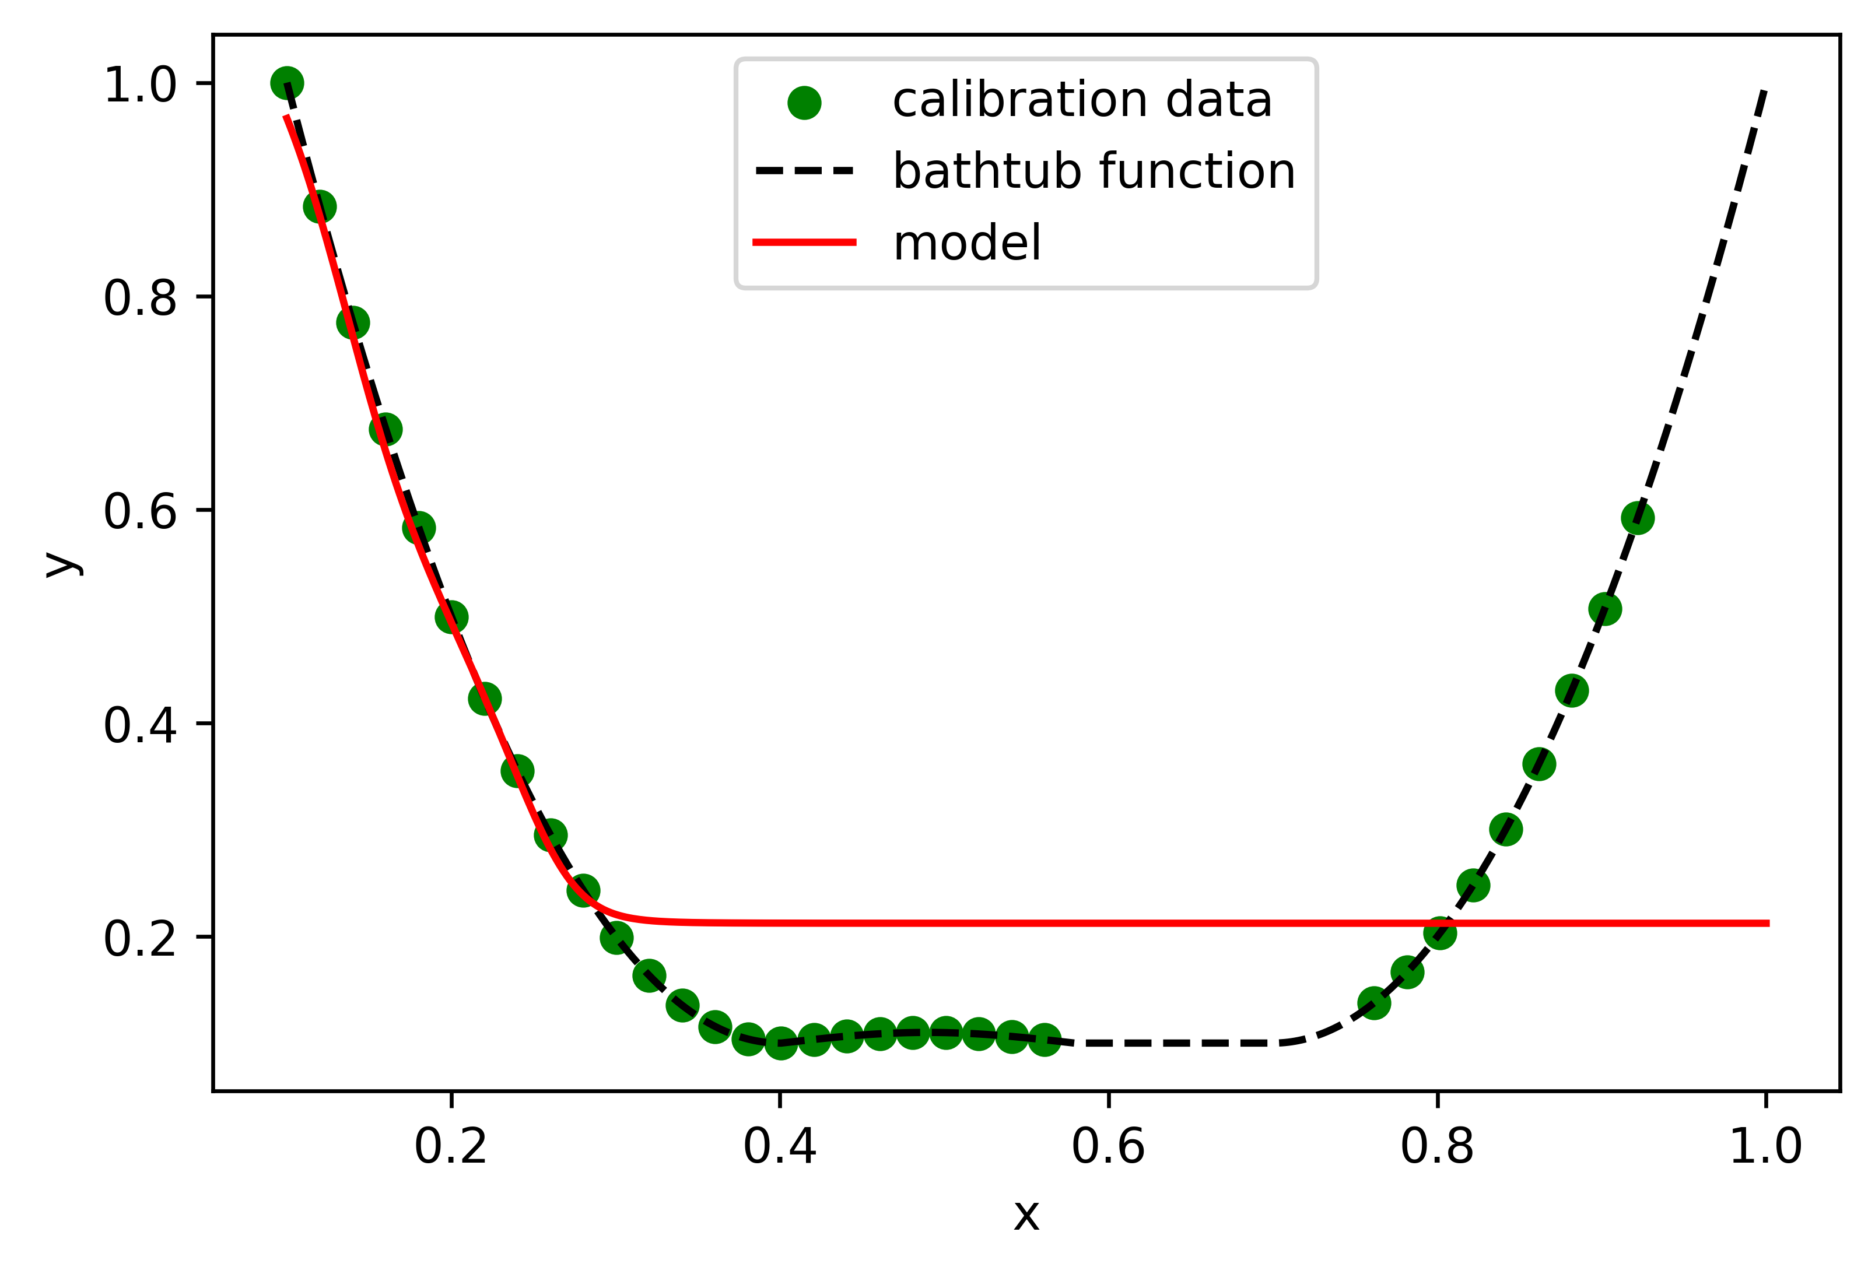
Hyperparameter sweep
Model Complexity…
It’s not that simple
It‘s difficult to underfit on this simple data
Underfitting might have different causes

Slide 6
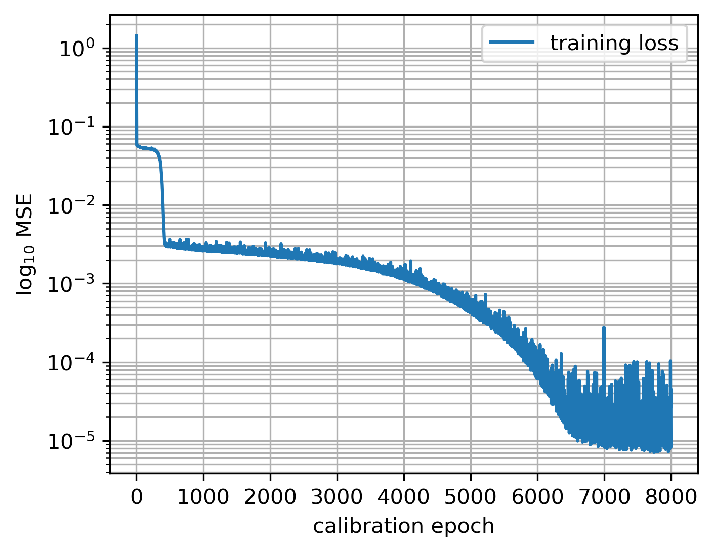
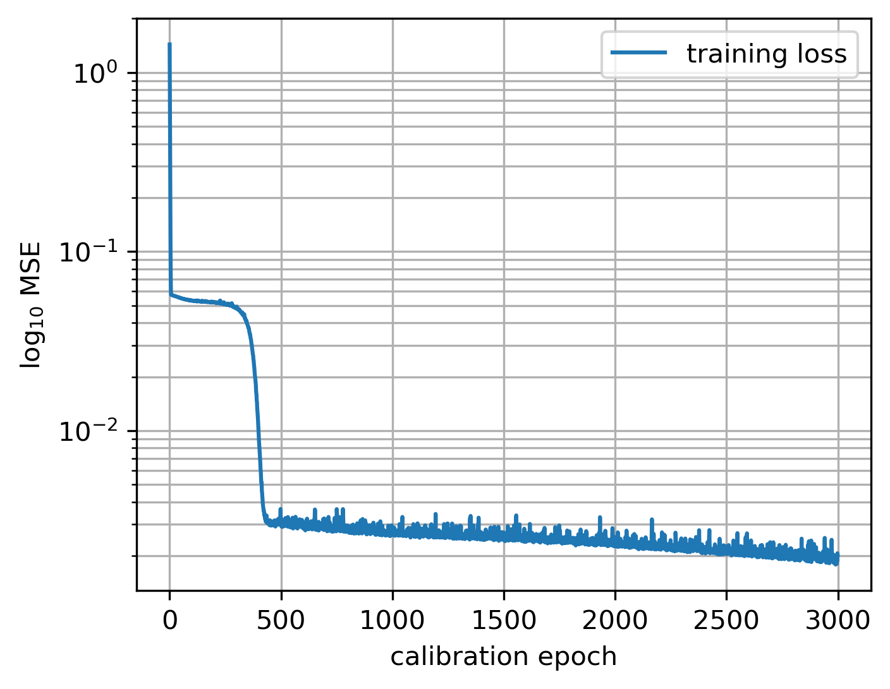
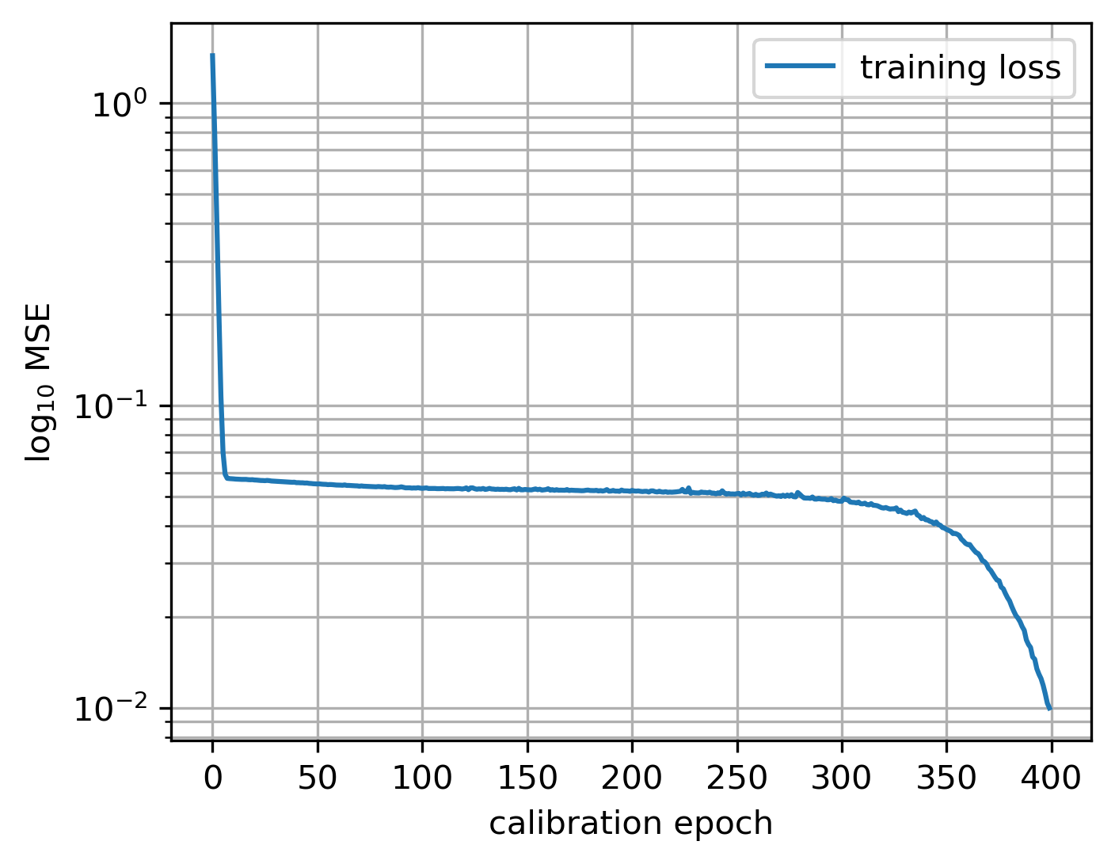
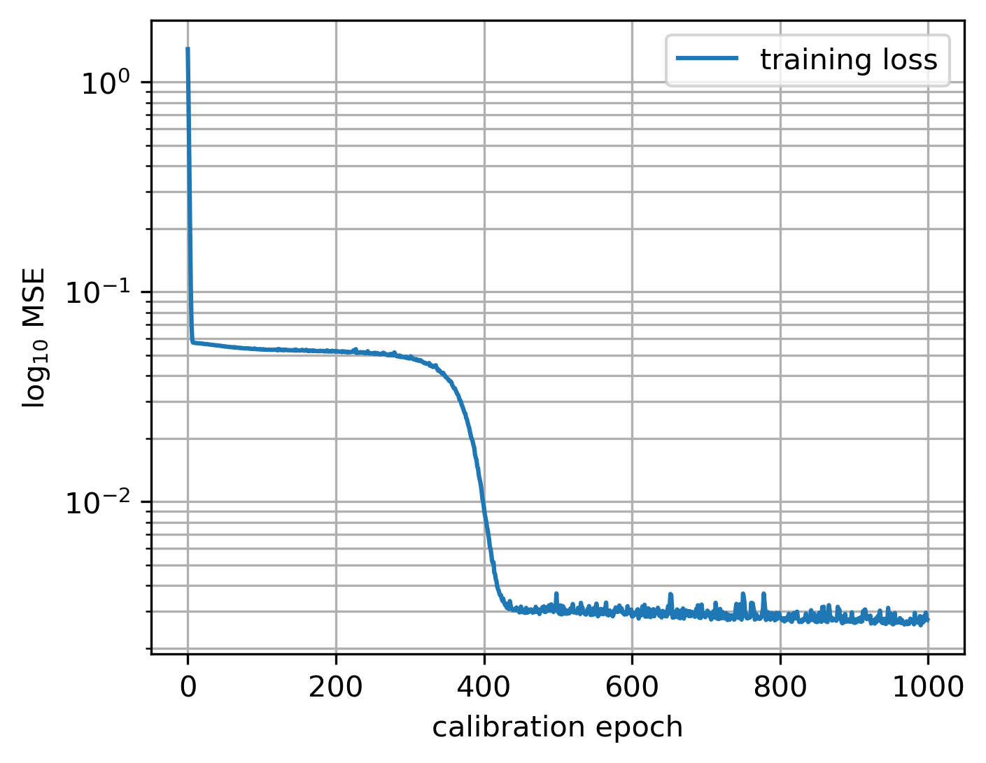
Hyperparameter sweep
Number of Epochs
Train until convergence
“False“ convergence

Slide 7
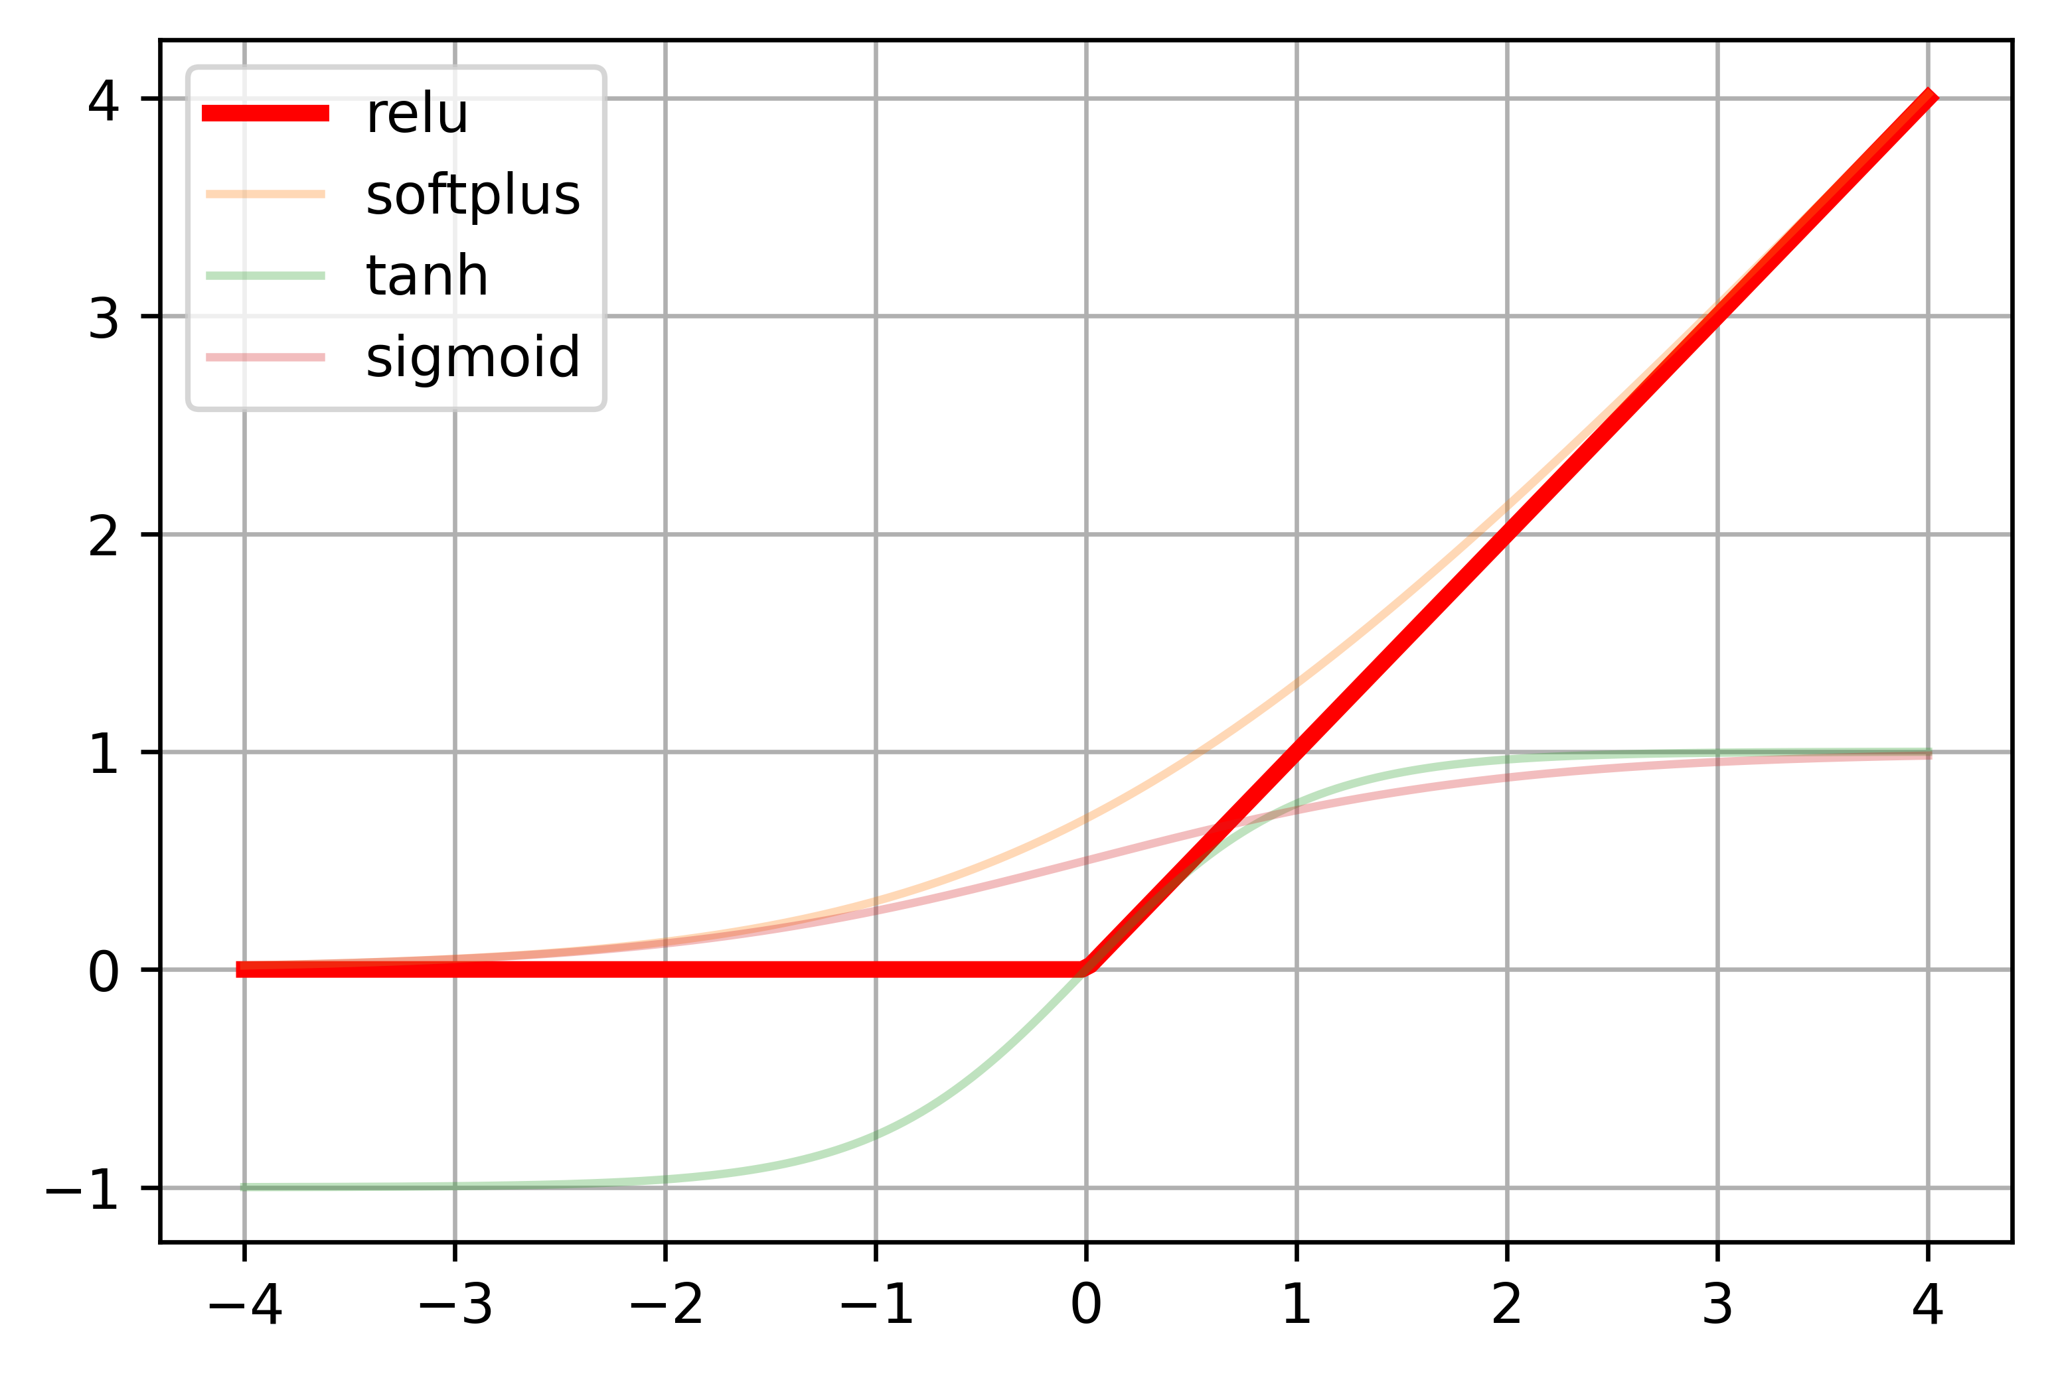
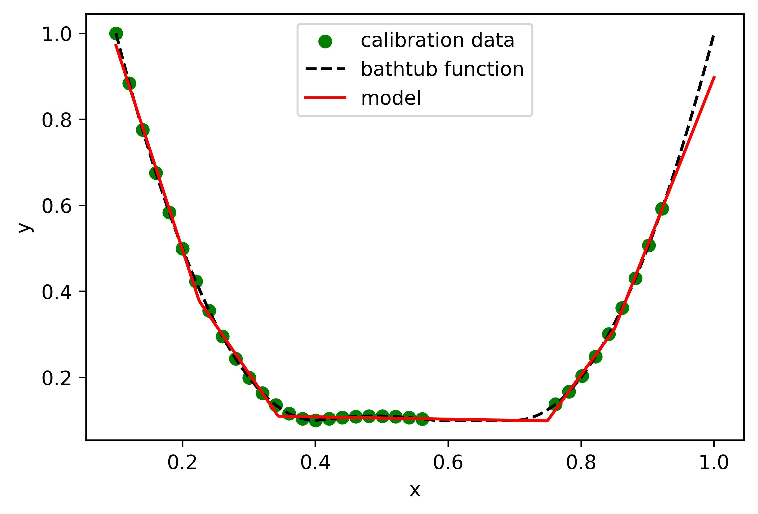
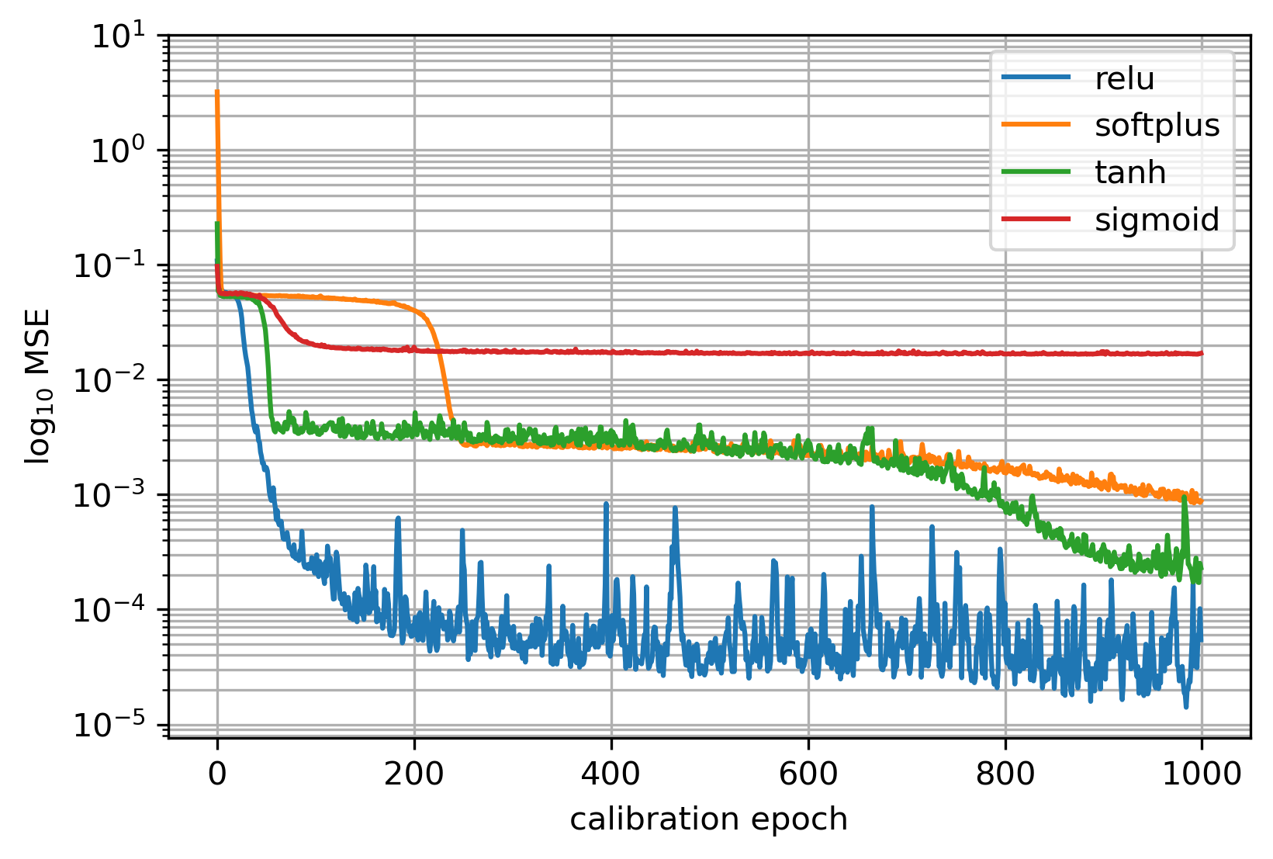
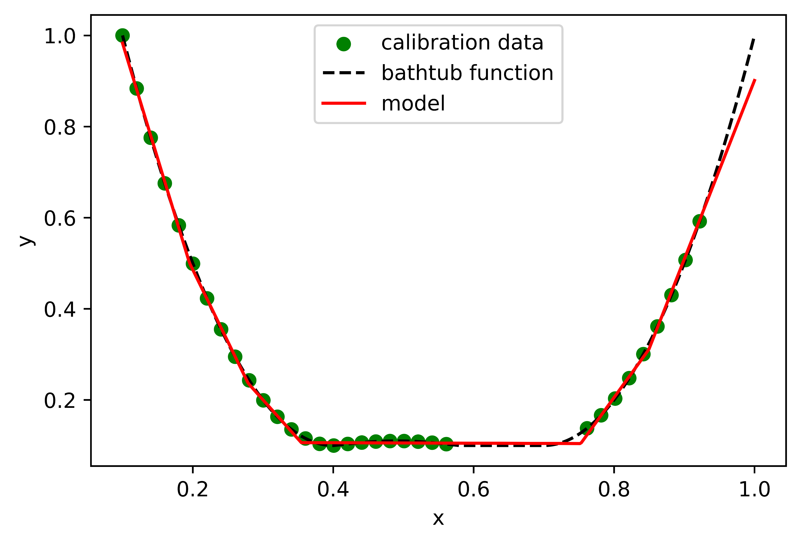
Hyperparameter sweep
Activation Functions -
RELU
Not continuously differentiable
Fast convergence

Slide 8
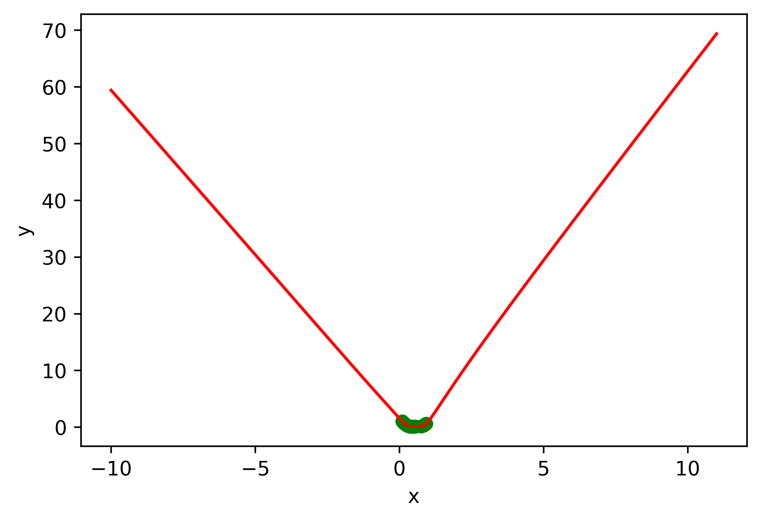
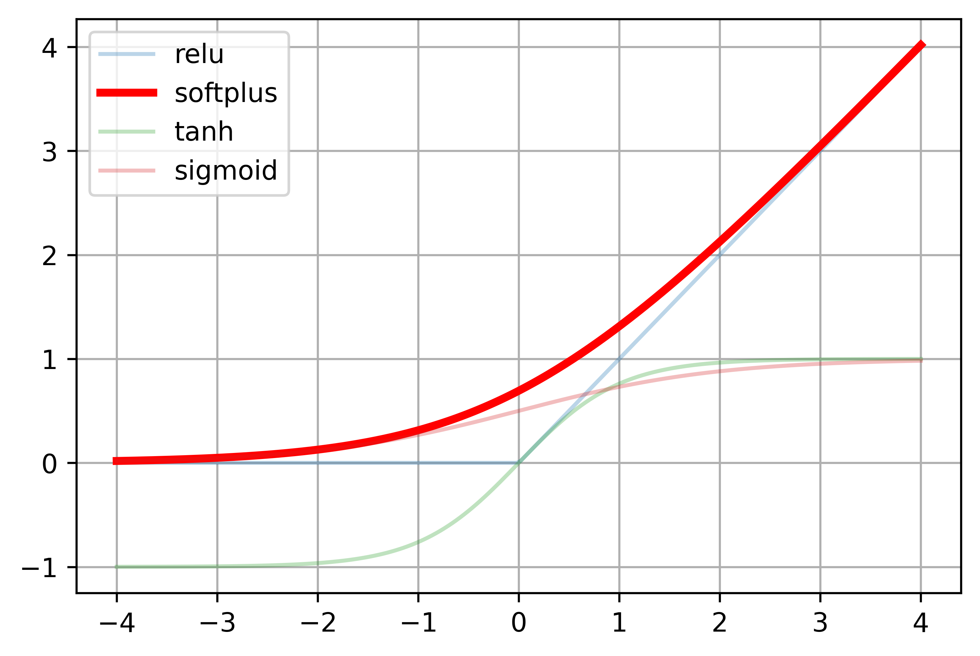
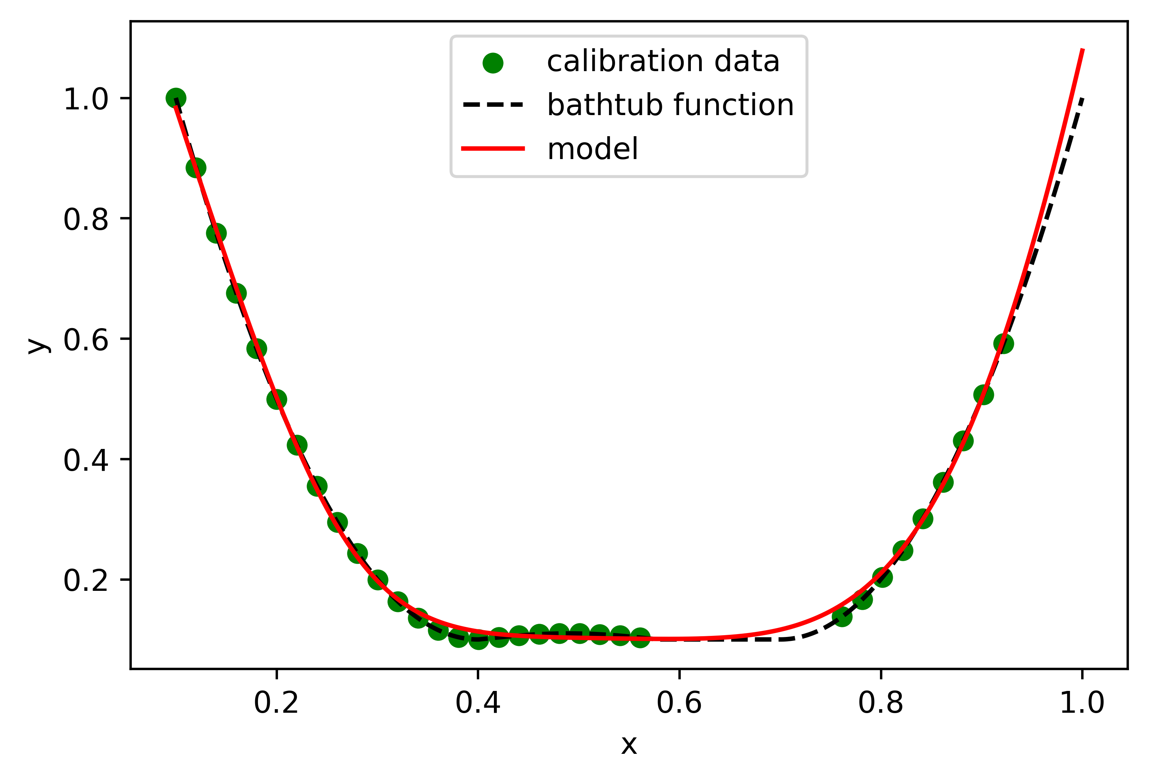
Hyperparameter sweep
Activation Functions -
Softplus
Infinitely differentiable
Unbounded

Slide 9
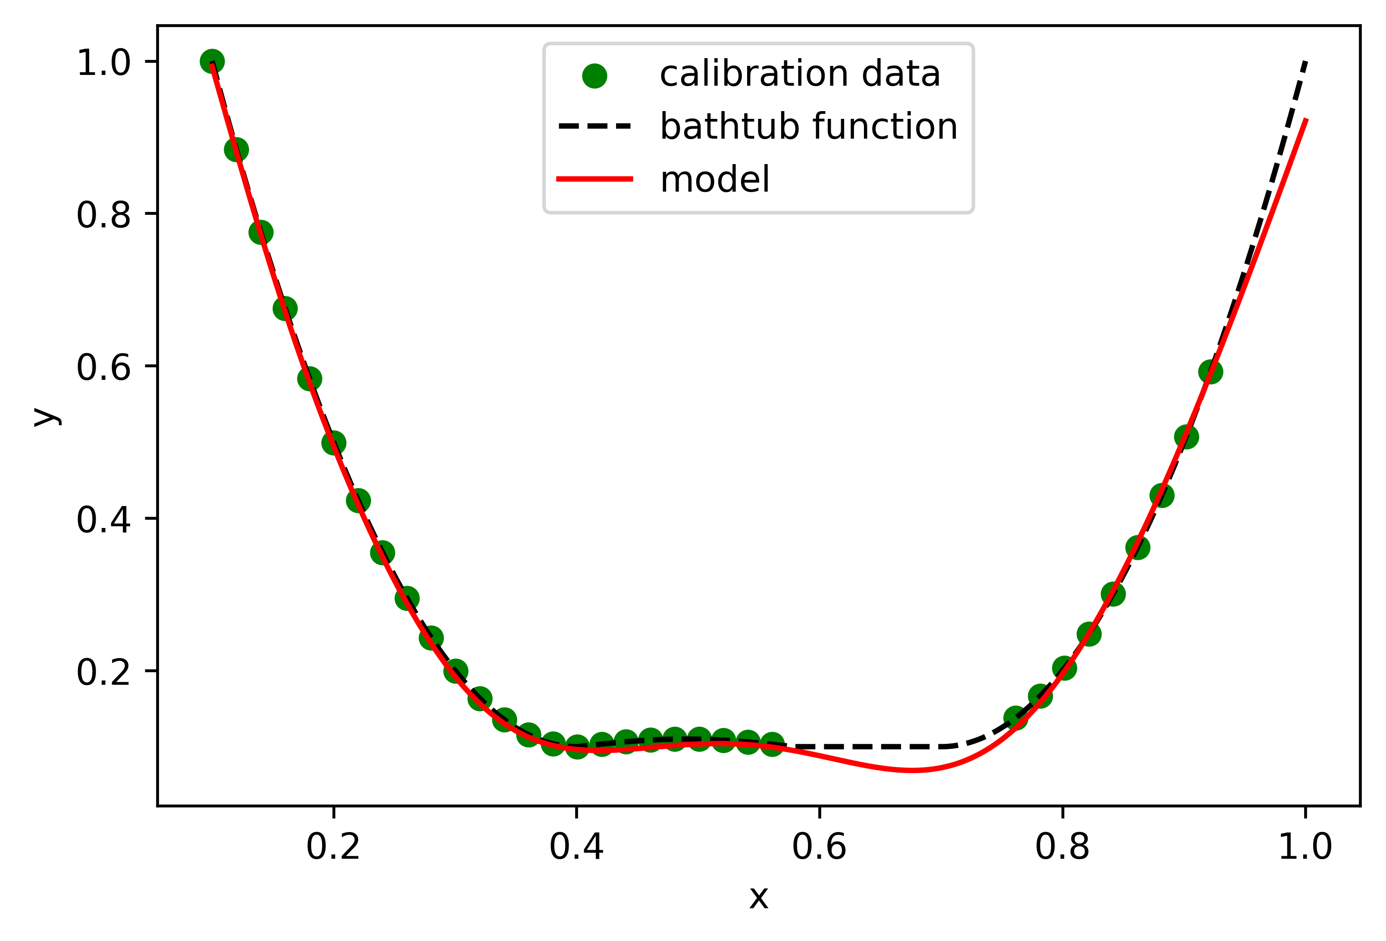
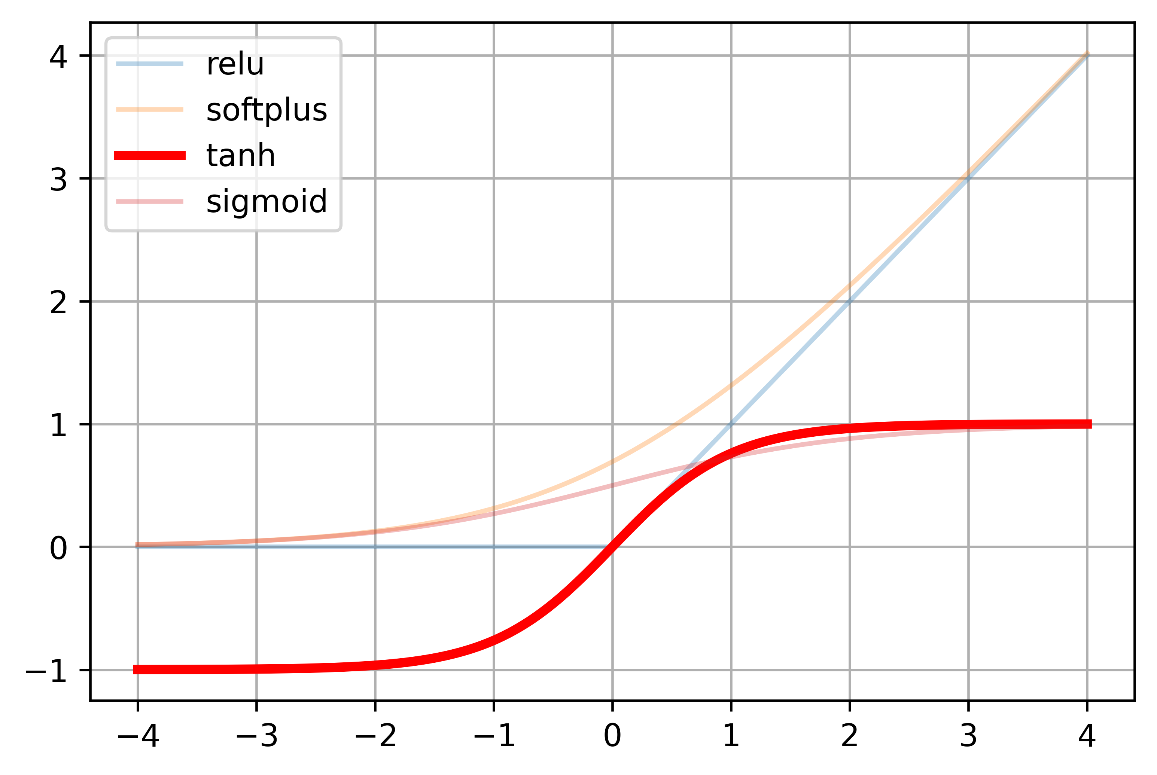
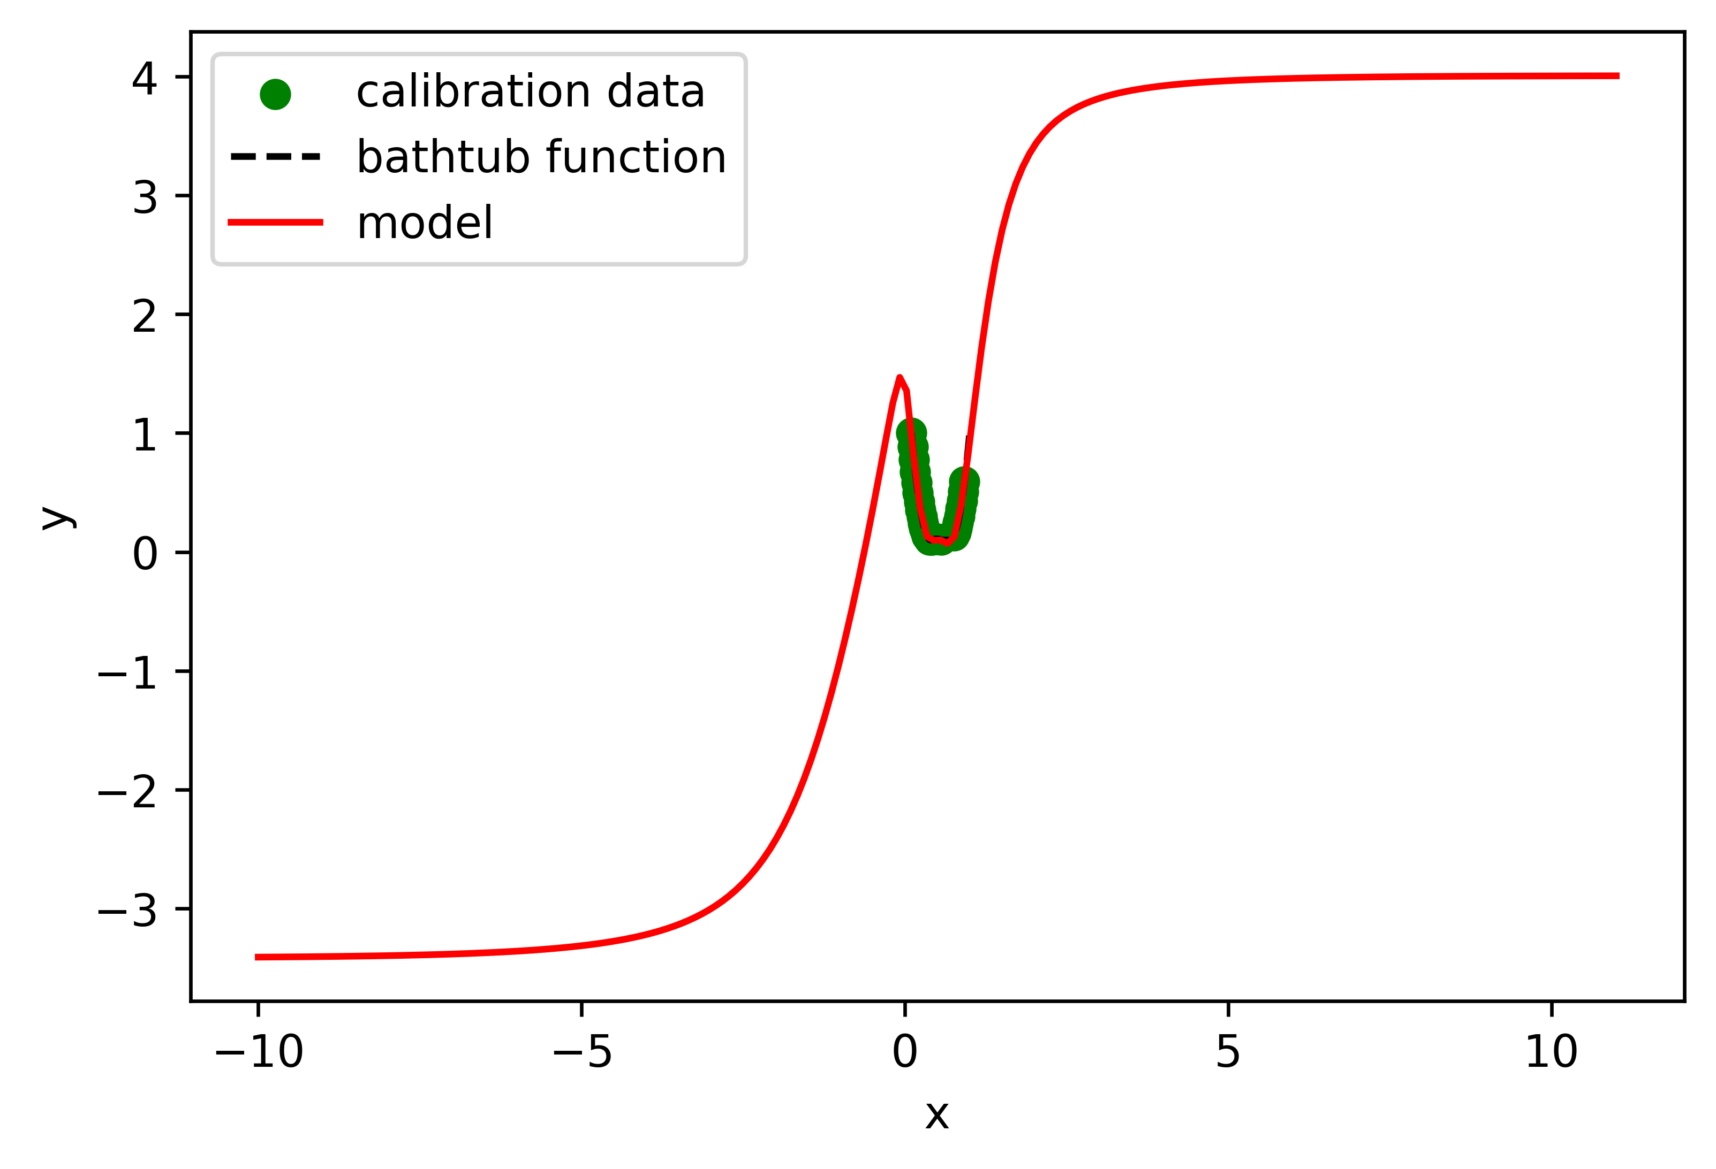
Hyperparameter sweep
Activation Functions -
tanh
Infinitely differentiable
Bounded

Slide 10
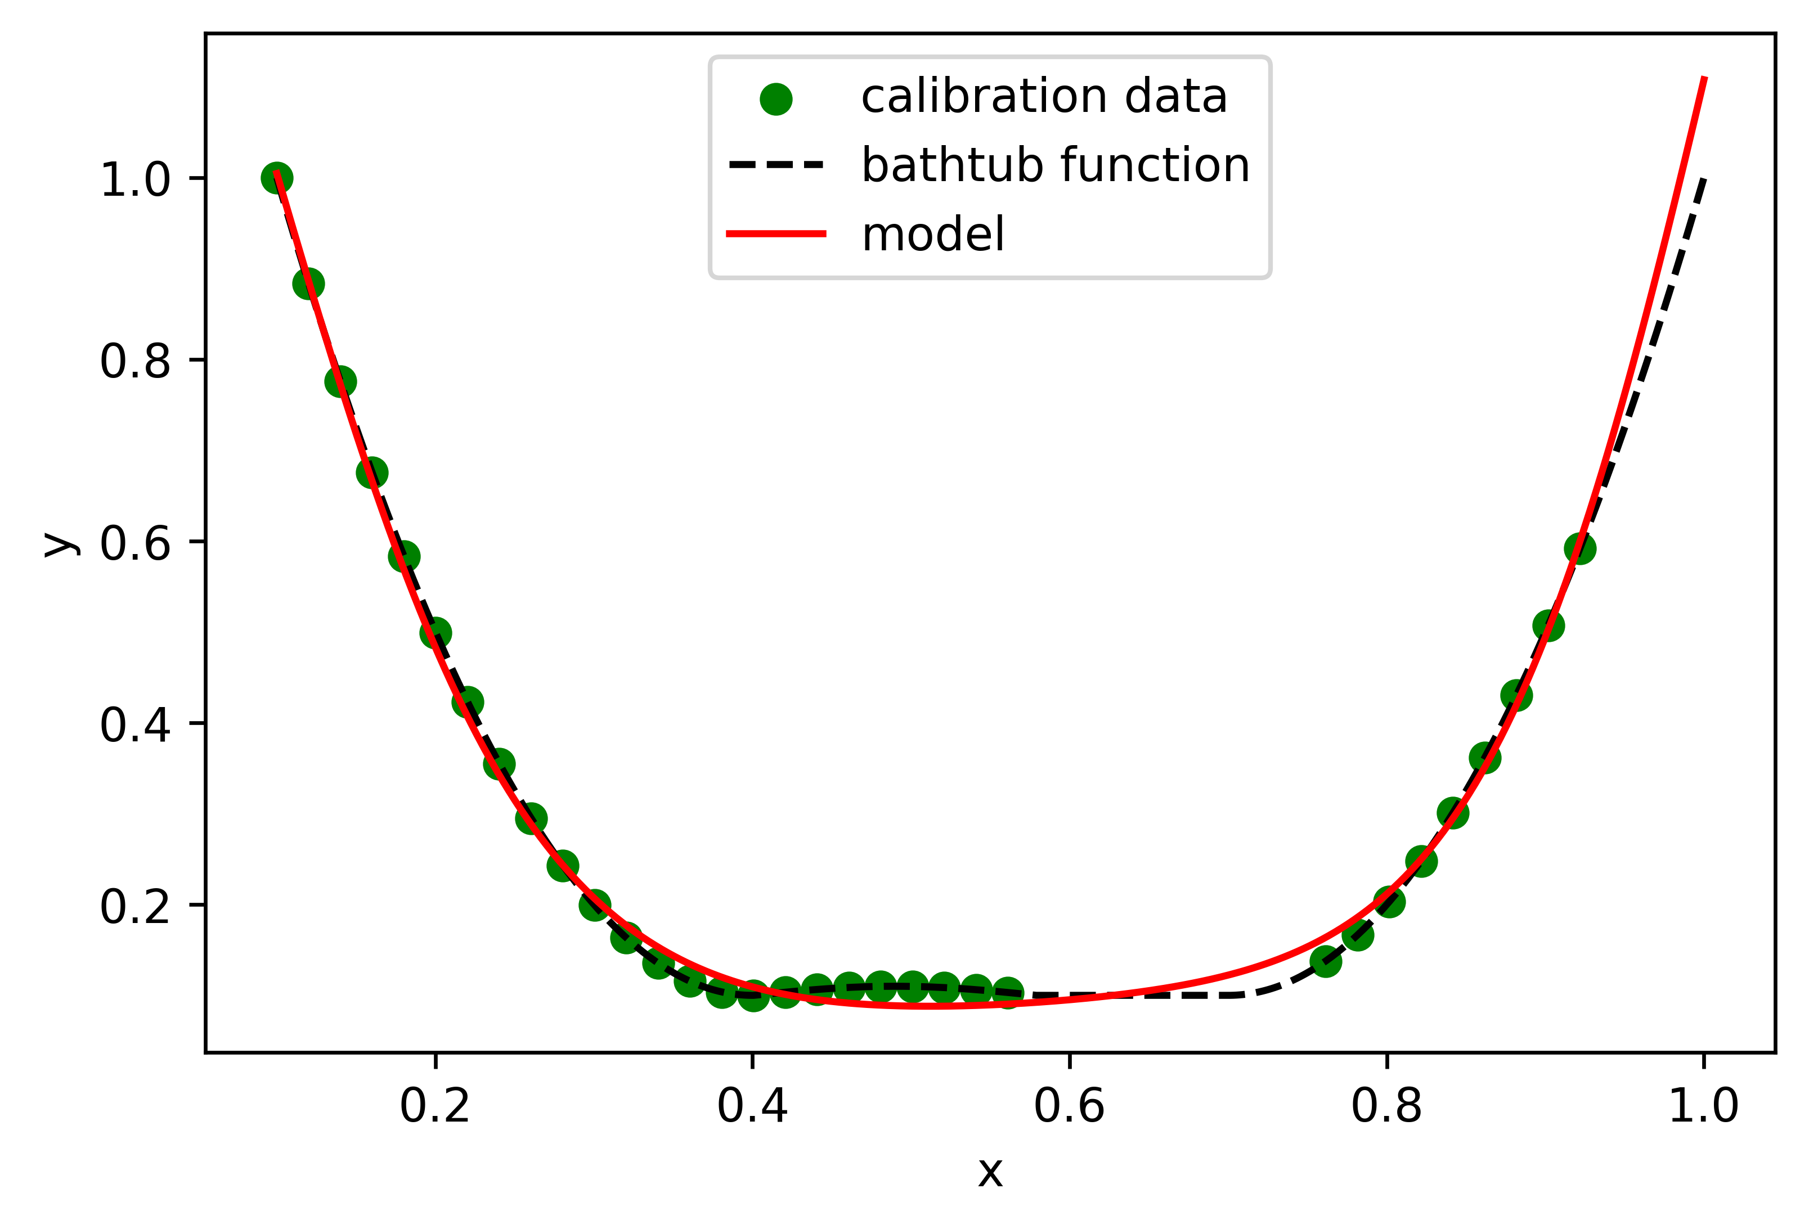
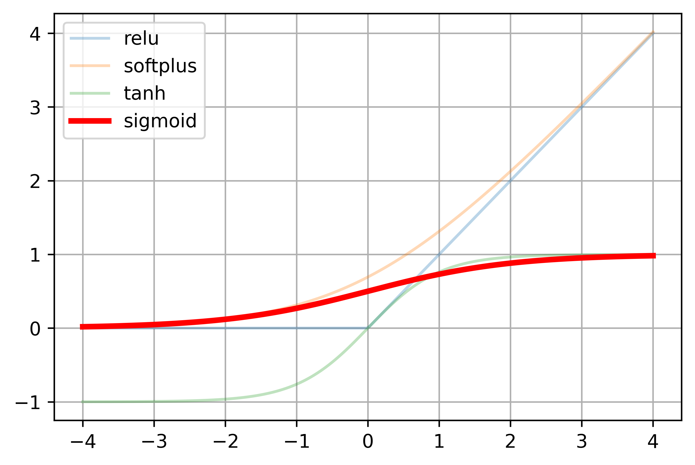
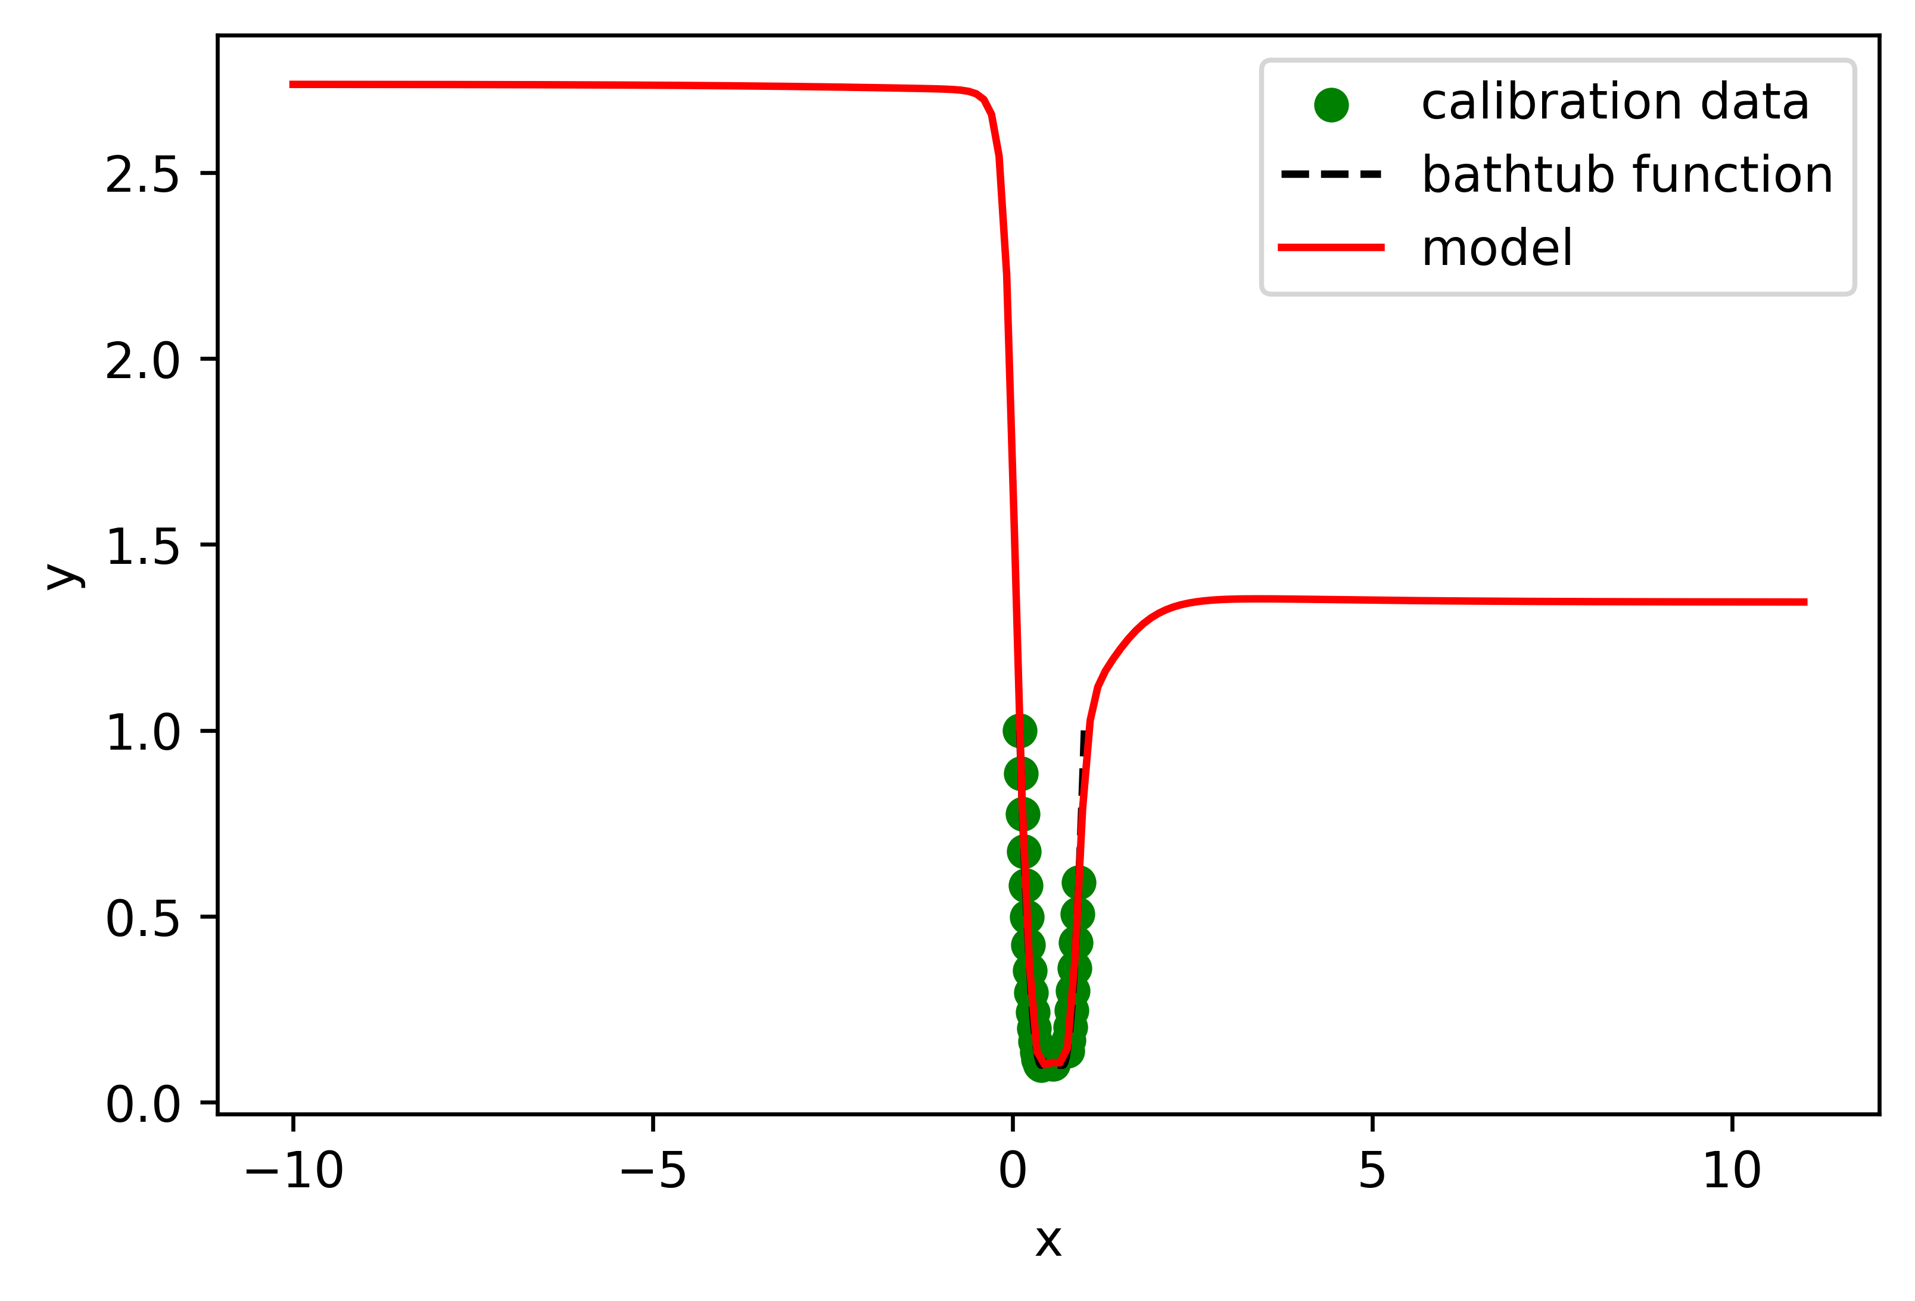
Hyperparameter sweep
Activation Functions -
Sigmoid
Infinitely differentiable
Bounded

Slide 11
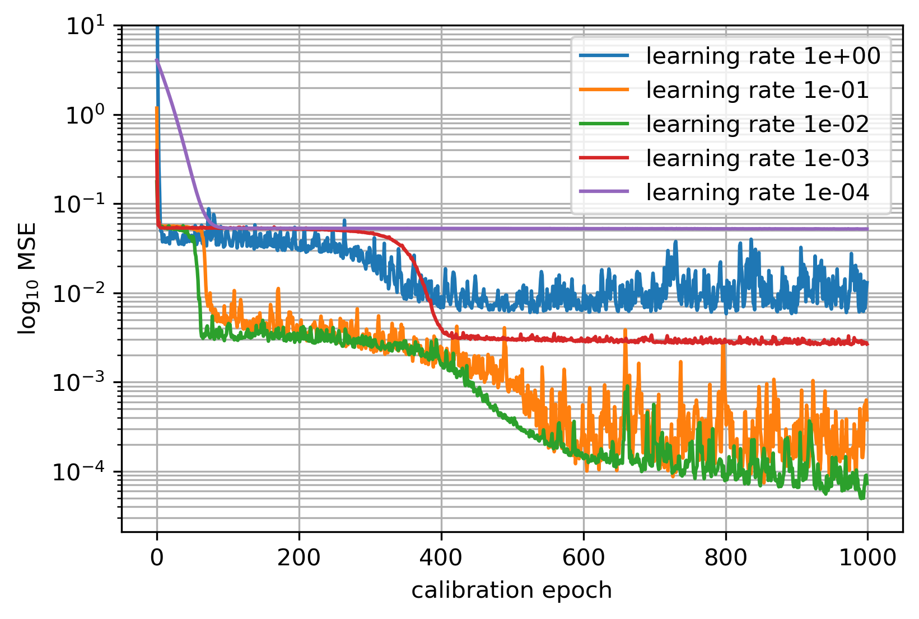
Hyperparameter sweep
Learning Rate
Problem specific optimal learning rate
Larger models require smaller learning rates

Slide 12
Hyperparameter sweep
Conclusion
Model Complexity: Complex “enough”
Number of epochs: “Enough” to converge
Activation function: Depends on use case. Differentiability, boundedness, convexity, …
All parameters affect each other.
Experimentation/parameter studies necessary

Slide 13
Task 1 – 1.2
Input convex neural networks

Slide 14
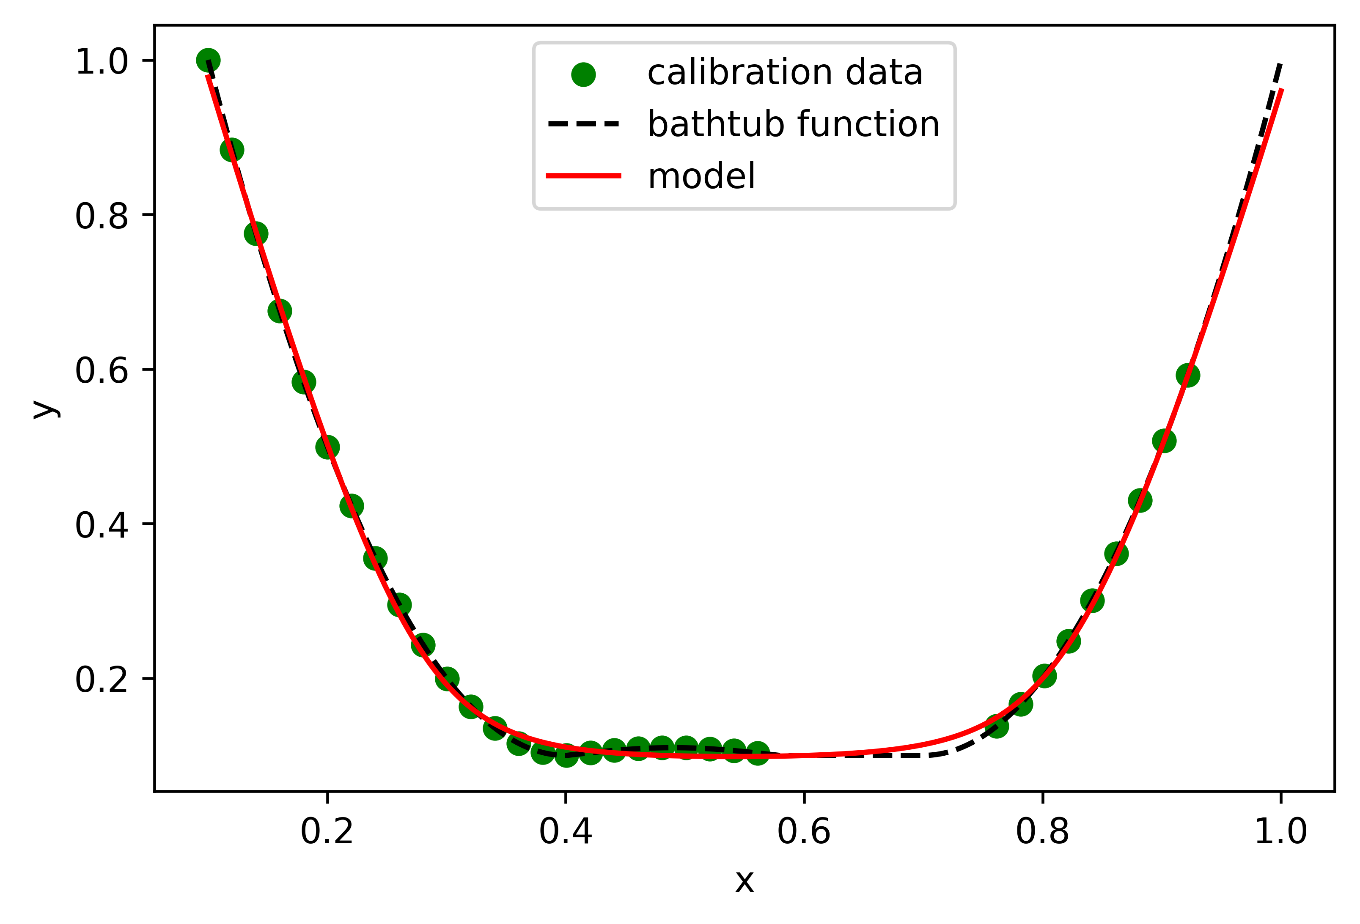
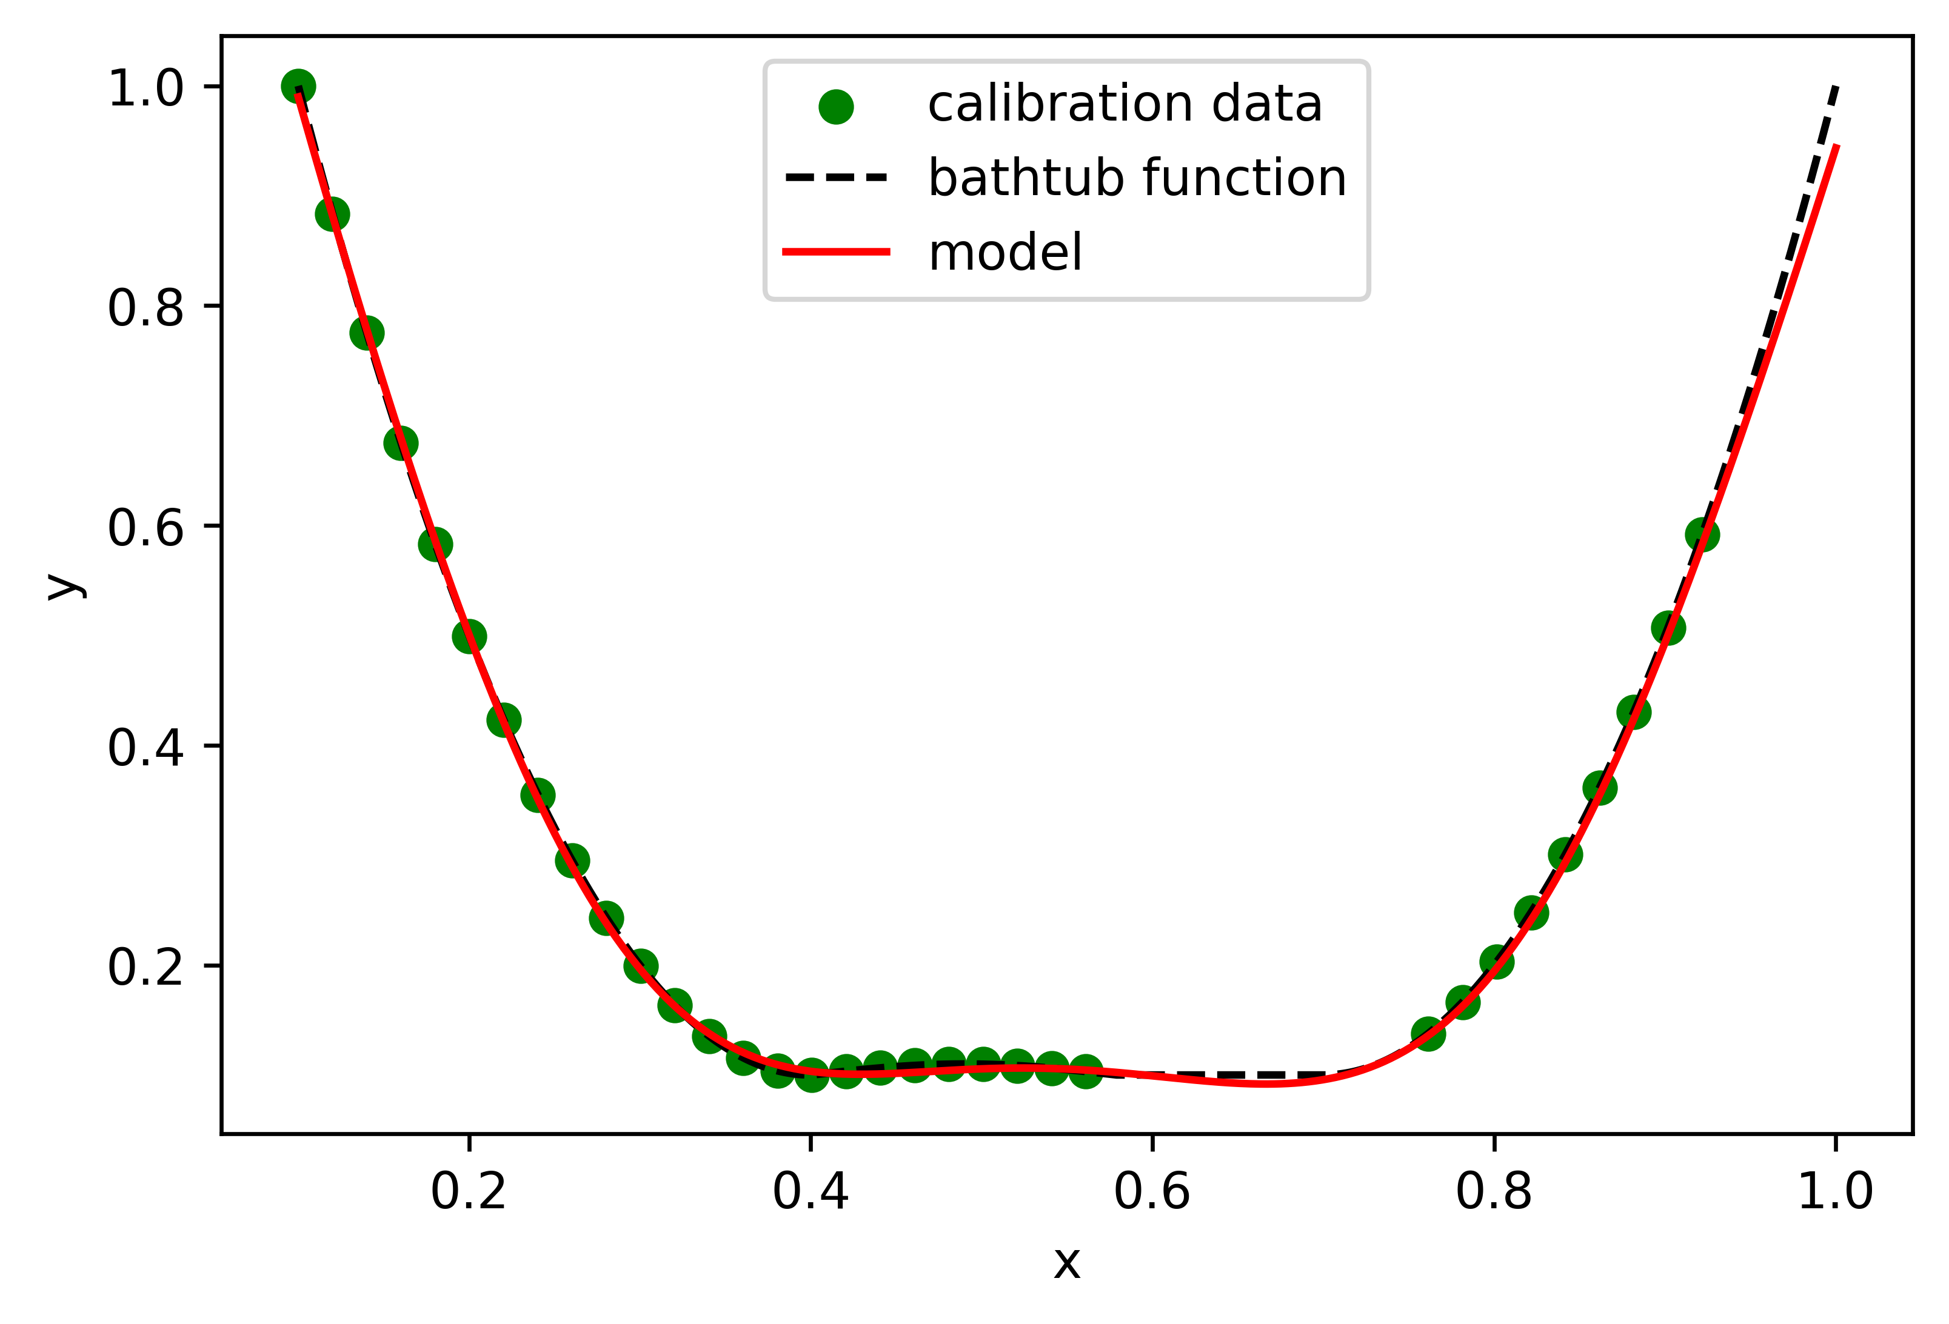
Input convex neural networks
Comparison
ICNN
FFNN
Convex
Slower convergence
Up to 50% zero-weights
Physically sensible inter- and extrapolation
Not convex
Faster convergence
Usually no zero-weights
Unpredictable inter- and extrapolation behavior

Slide 15
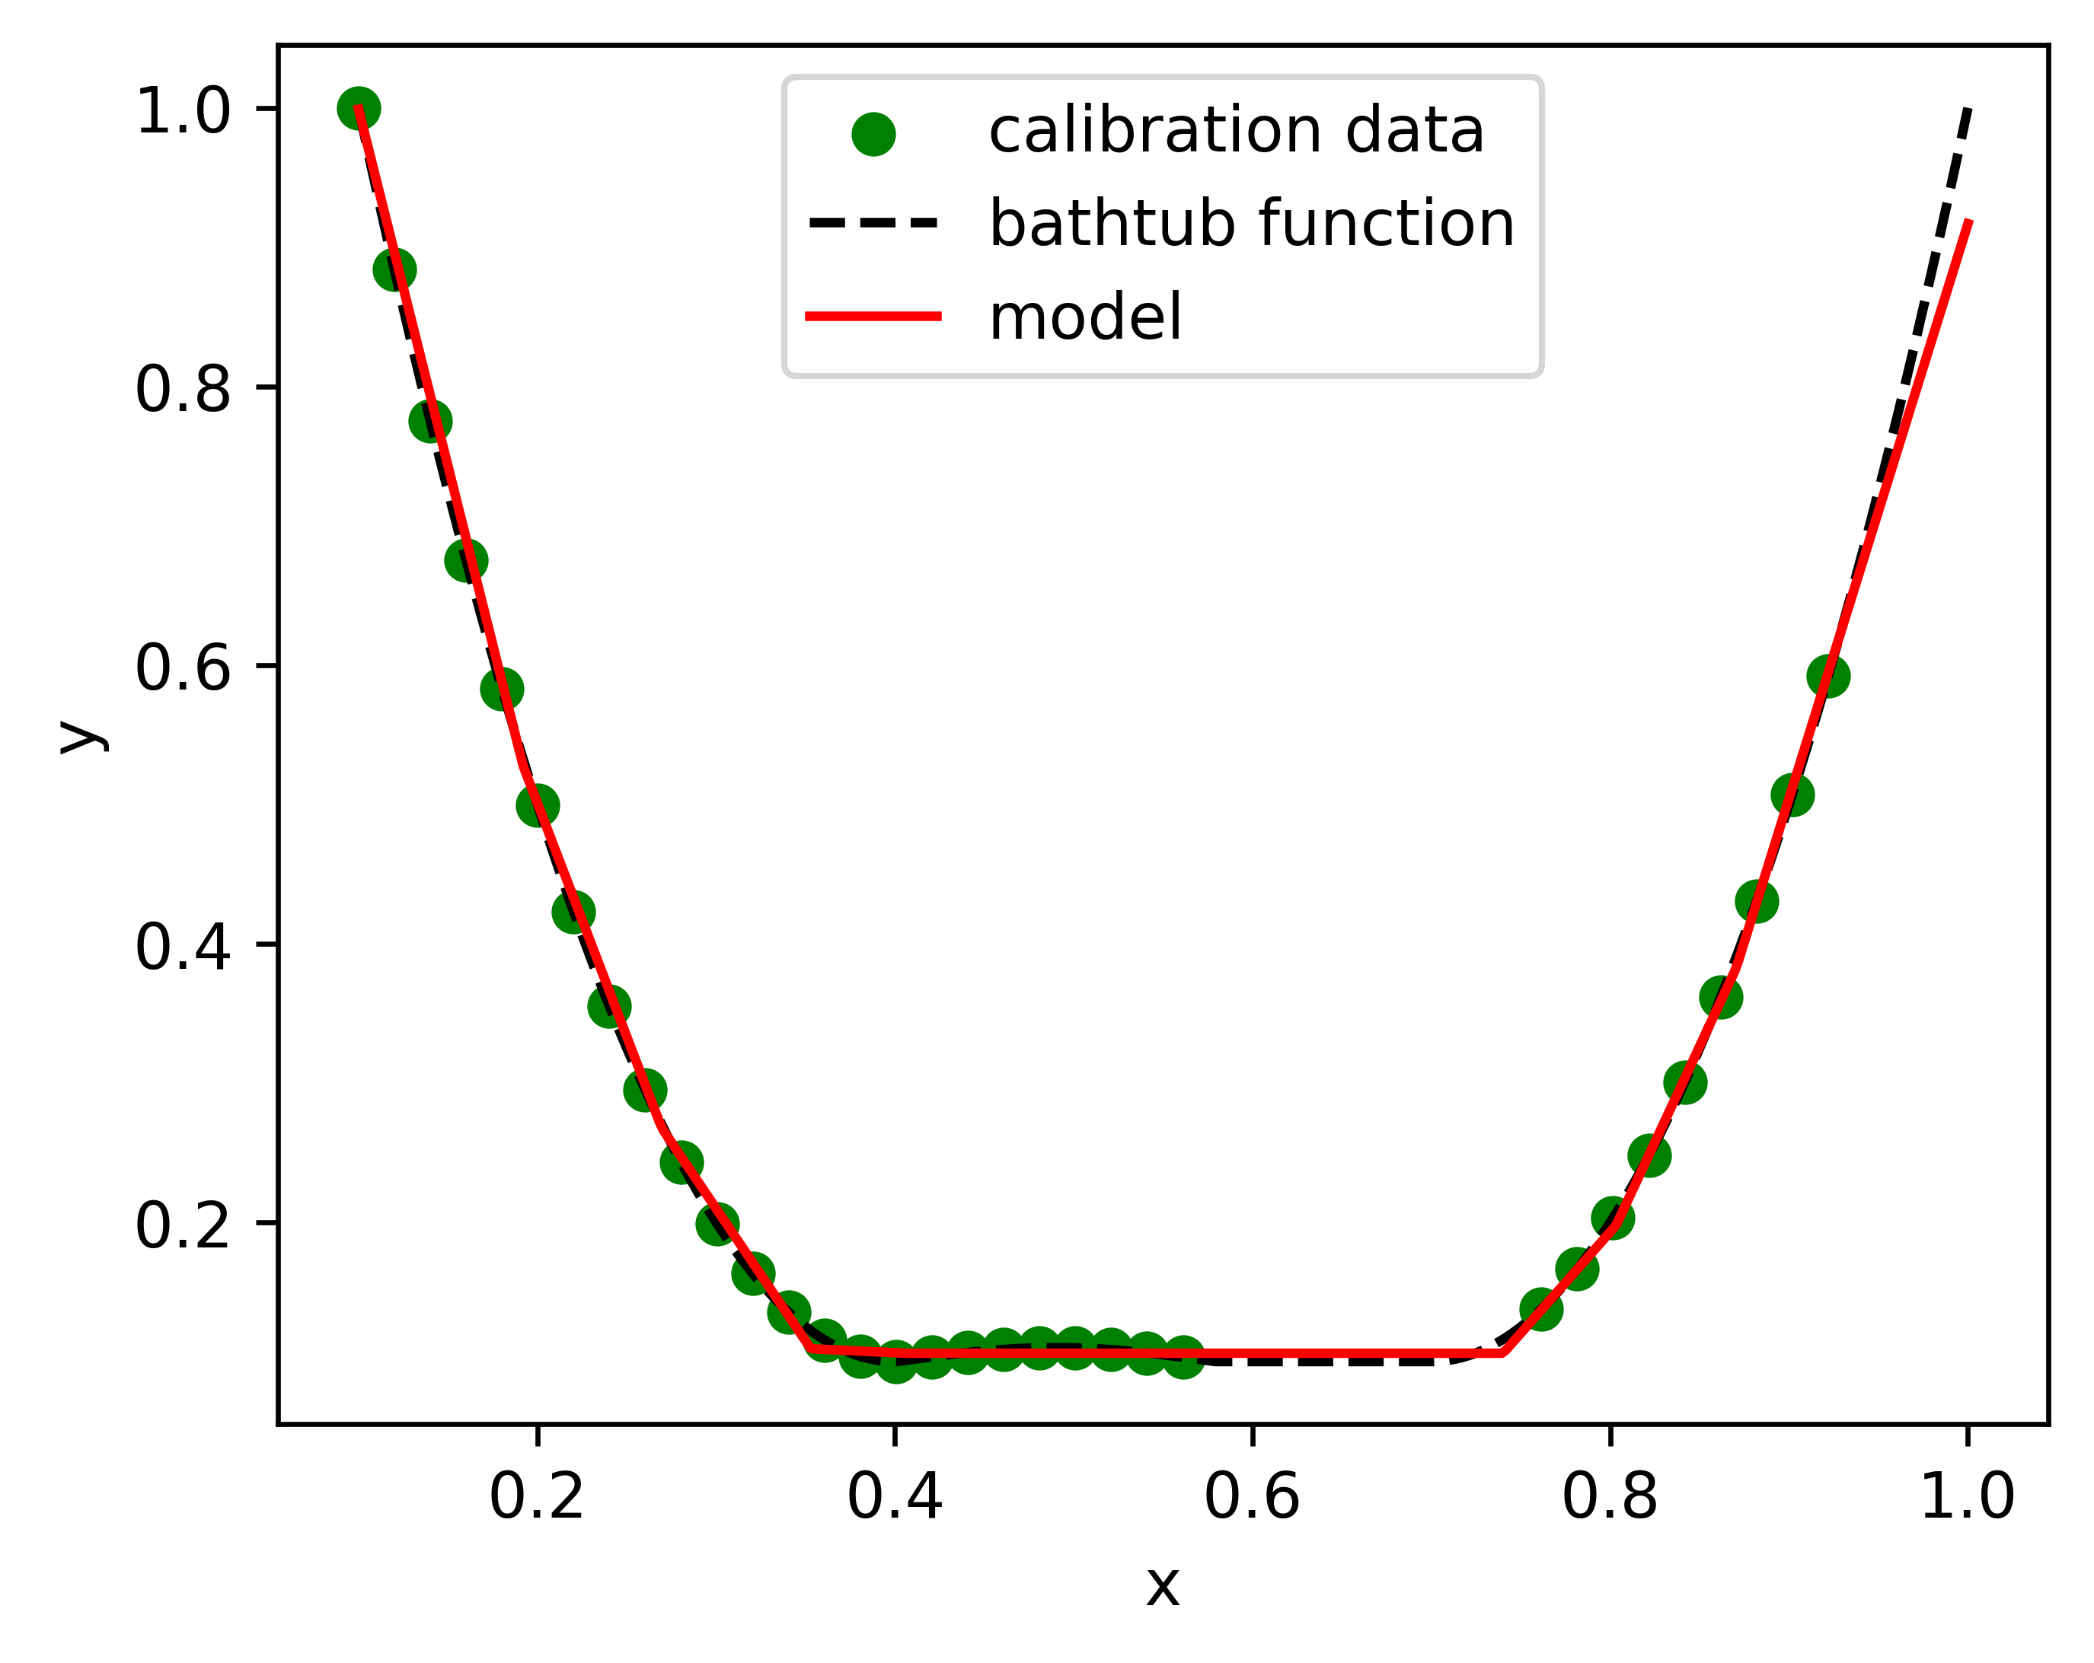
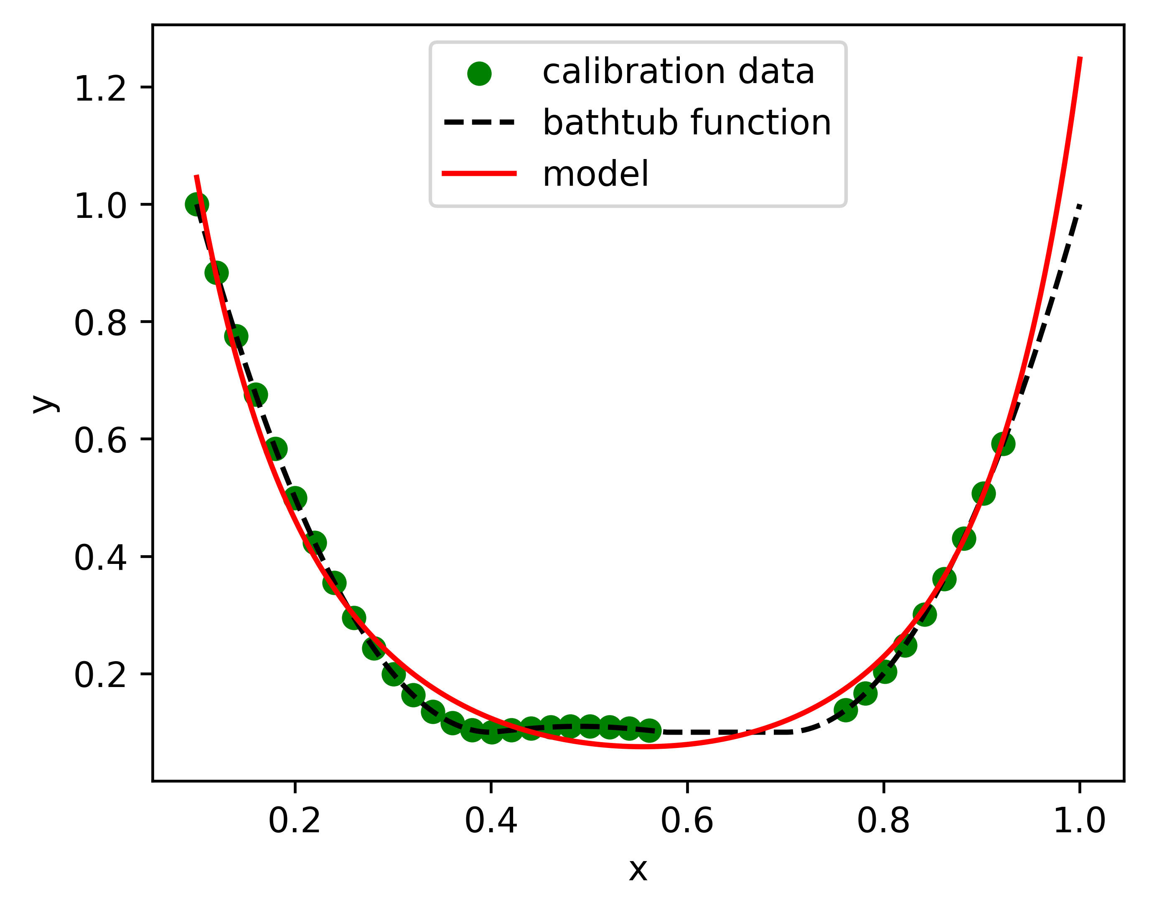
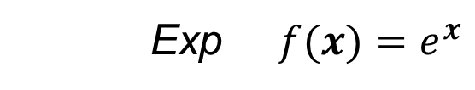
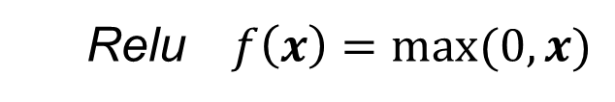
Input convex neural networks
Alternative ICNN Activation functions
All $f$ such that $\frac{d^{2}f}{{dx}^{2}}>0$, $\frac{df}{dx}>0$. E.g.,
Relu $f\left(x\right)=\max{(0,x)}$
Exp $f(x)=e^{x}$

Slide 16
Task 1 – 2.2
Trainable custom layer

Slide 17
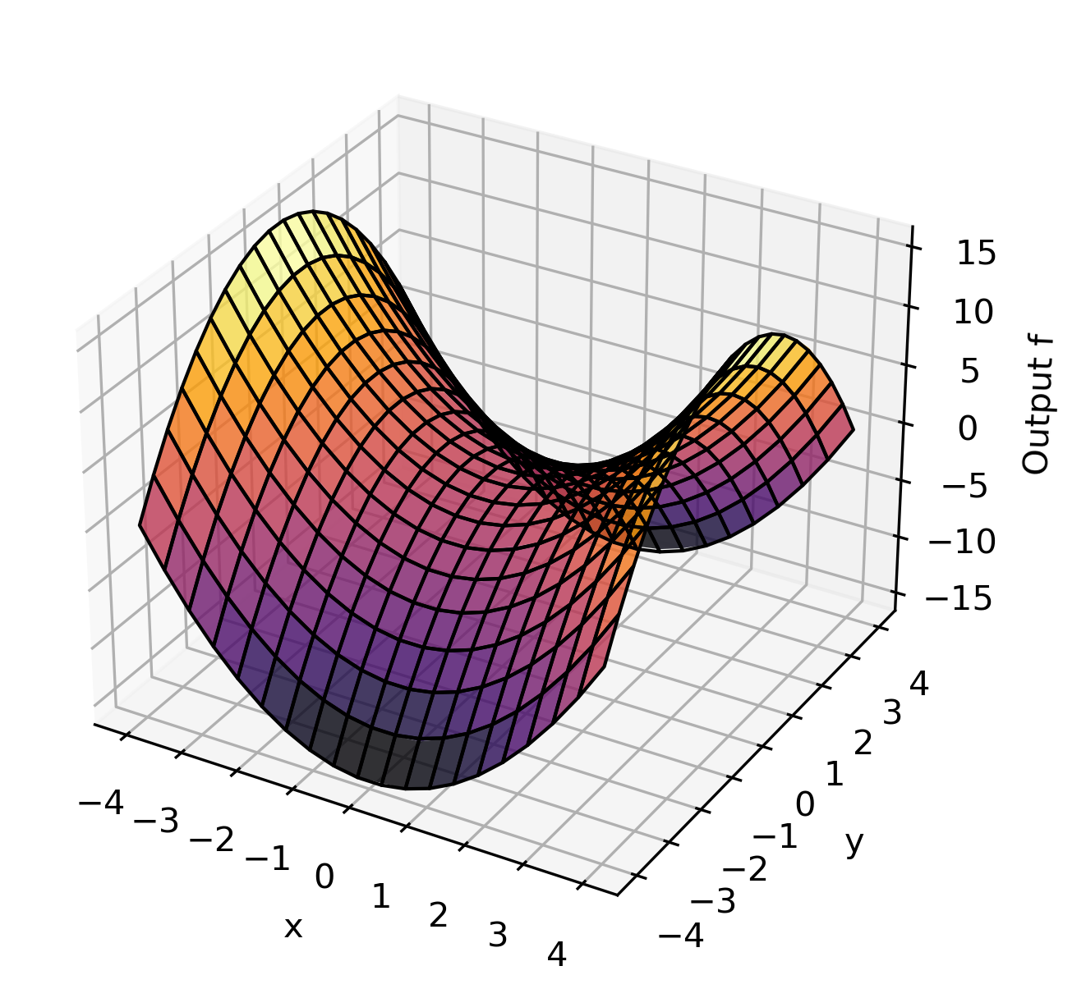
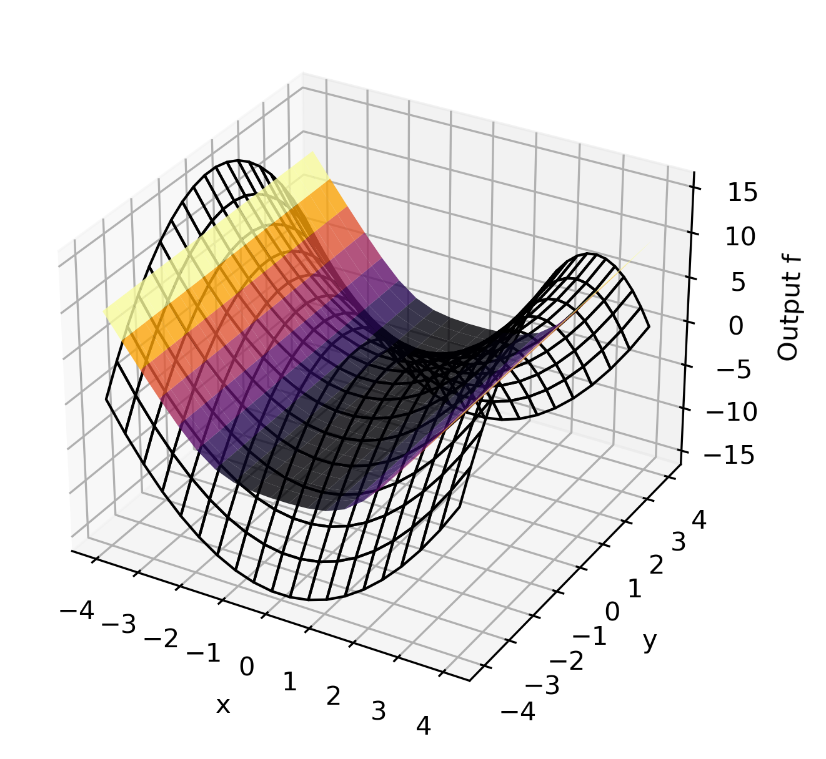
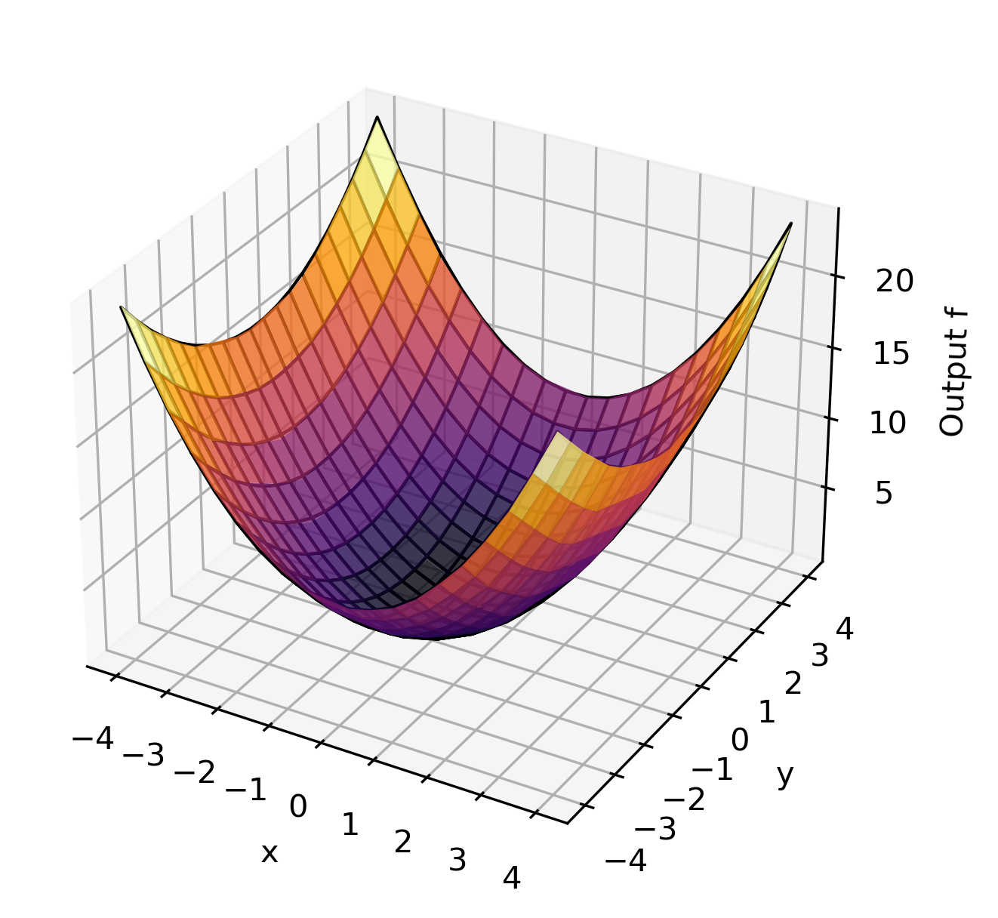

Trainable custom layer
Comparison
Non-Convex Data
Convex Data
FFNN
ICNN
FFNN
ICNN

Slide 18
Task 1 - 2.3
Sobolev training

Slide 19
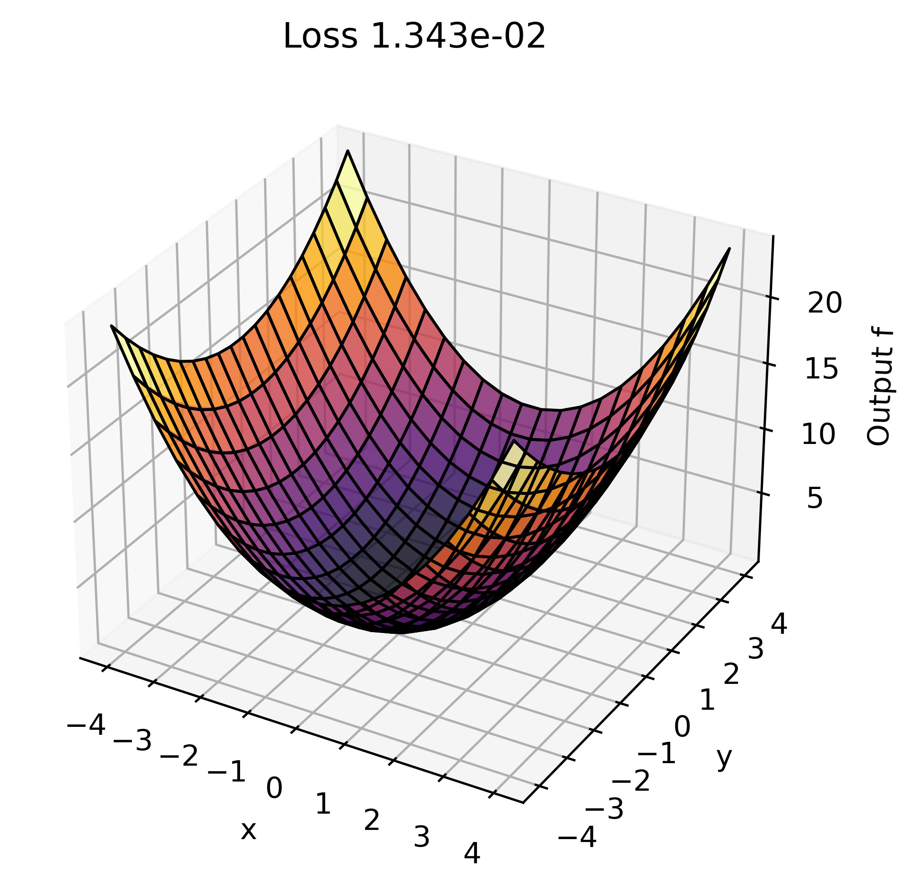

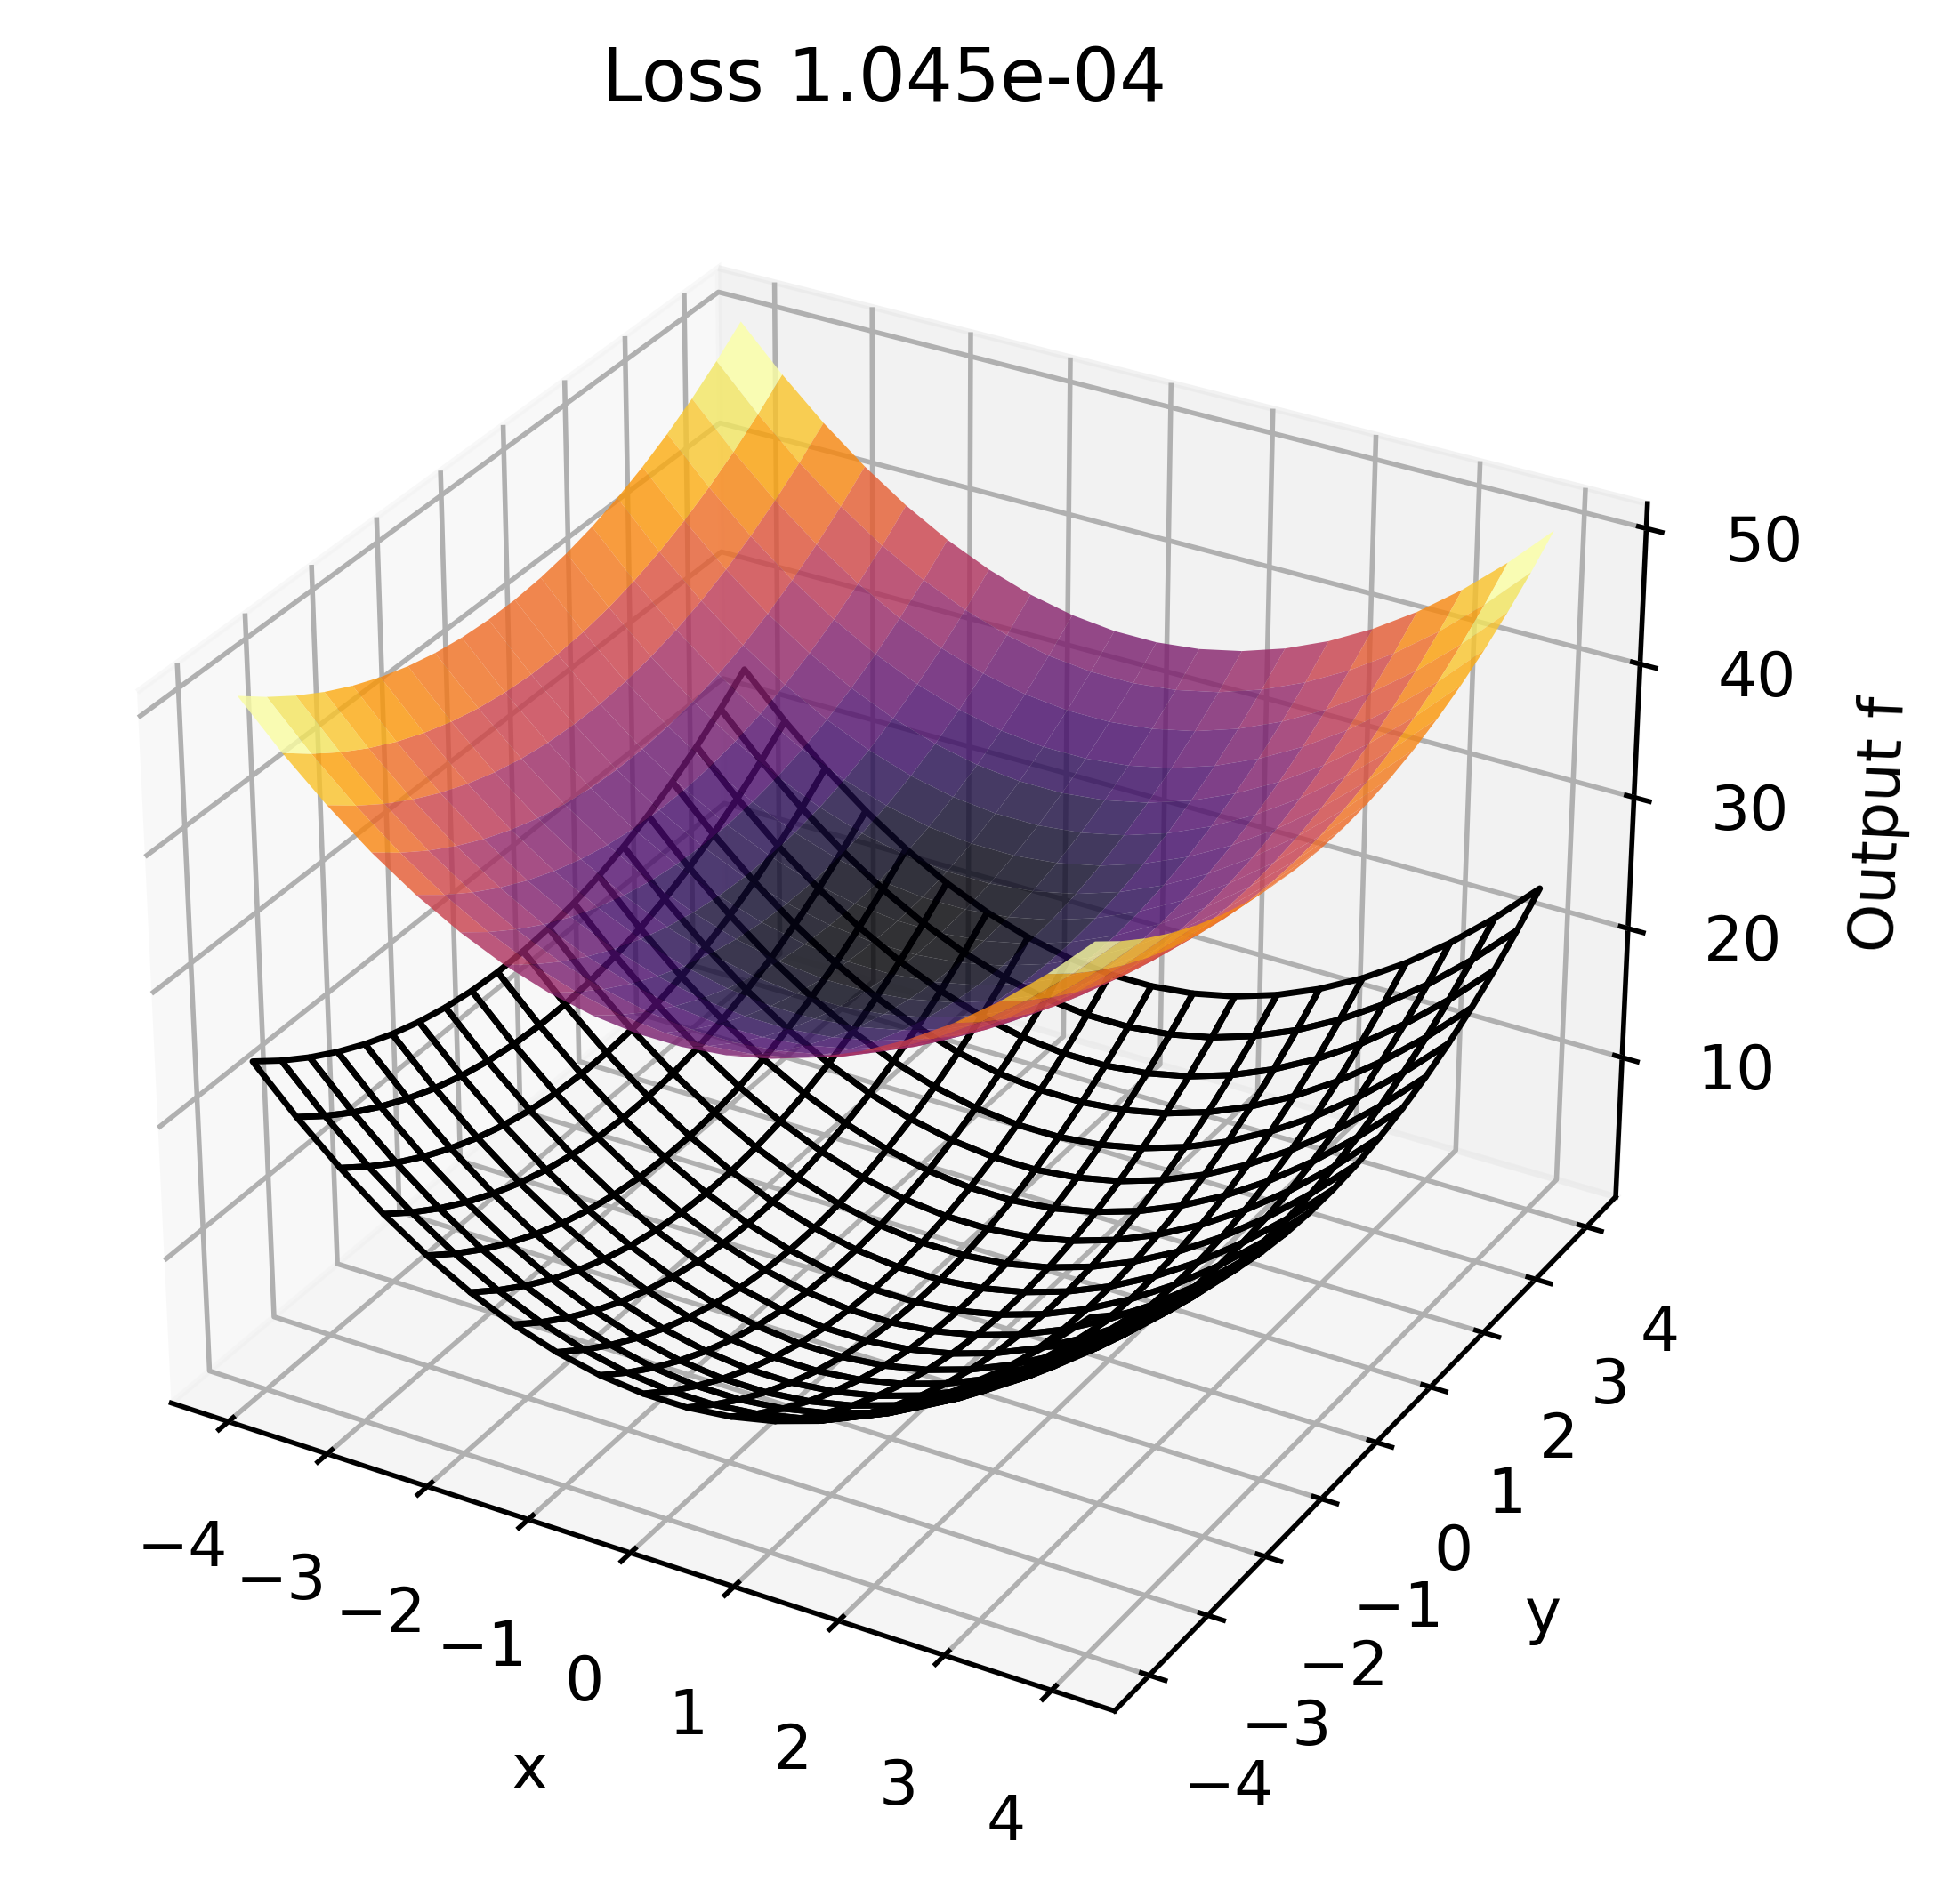
Sobolev training
Prediction
Function only
Function and gradient
Gradient only

Slide 20
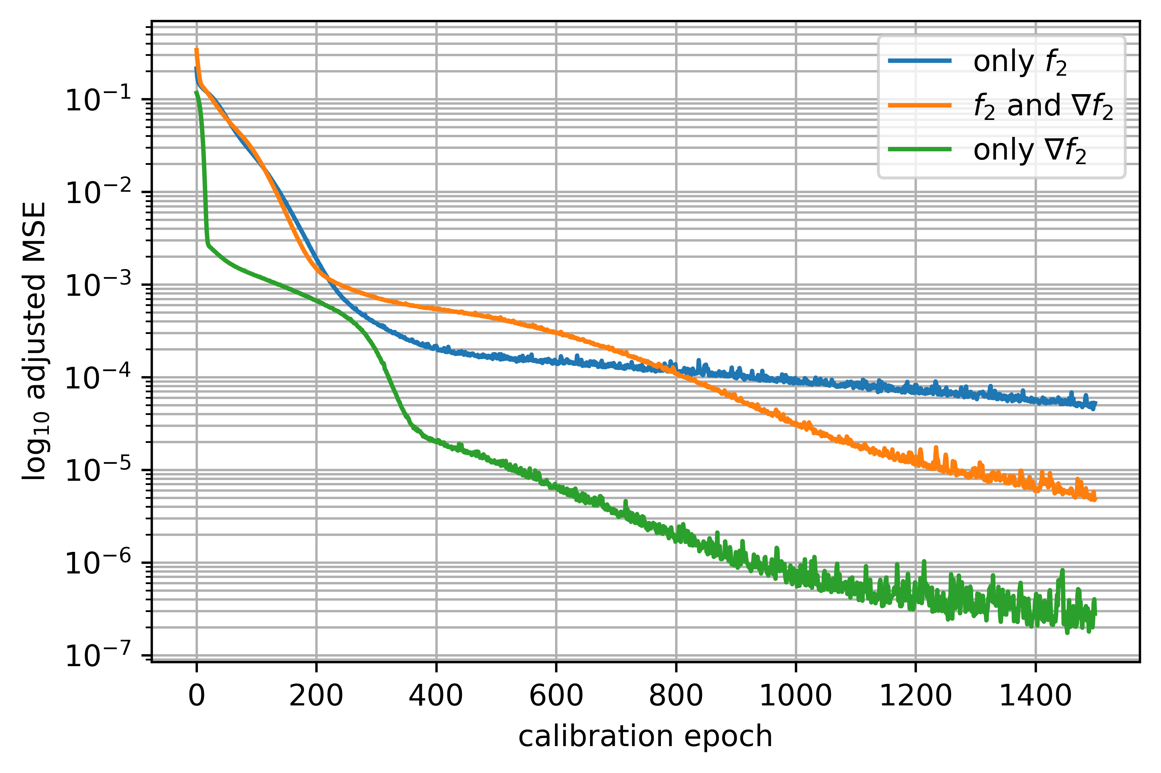
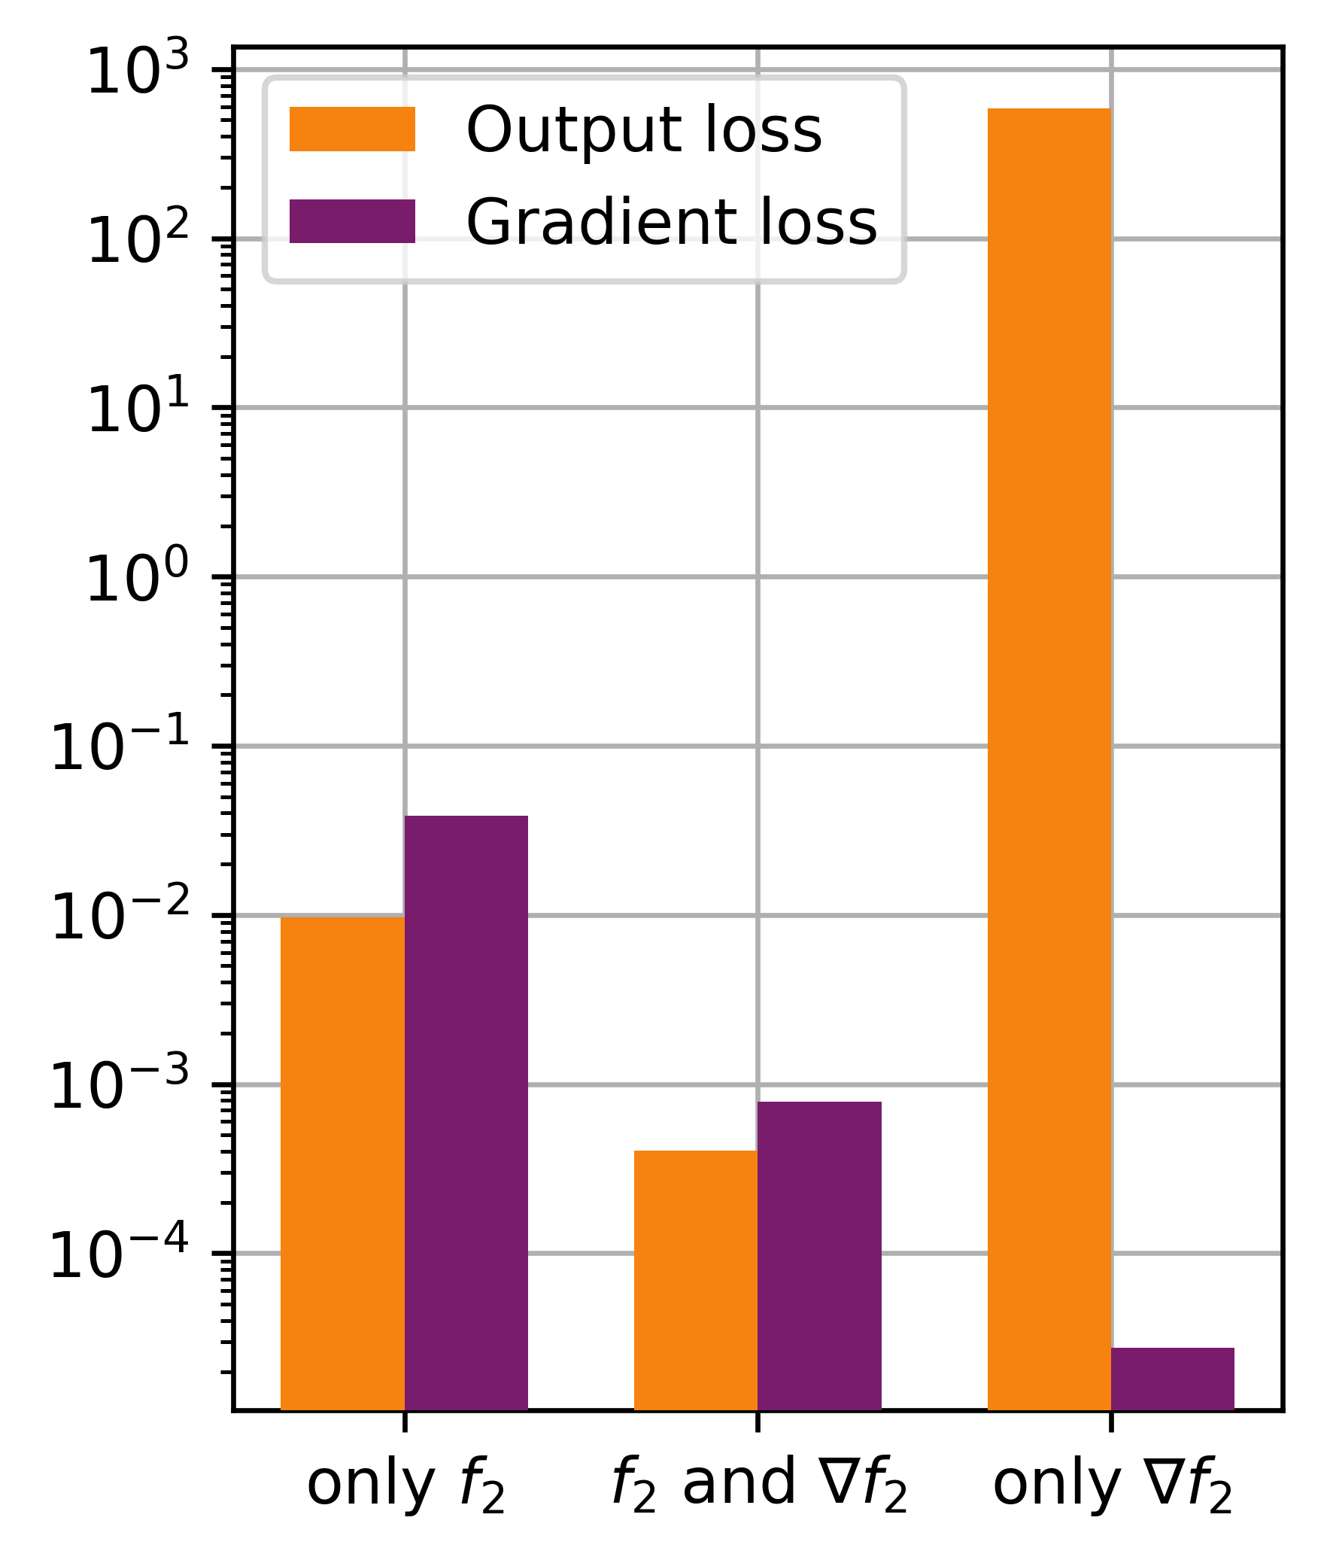
Sobolev training
Loss comparison
Training Loss
Evaluation Loss

Slide 21
Tutorial Machine Learning in Solid Mechanics
Discussion

